Slide 1
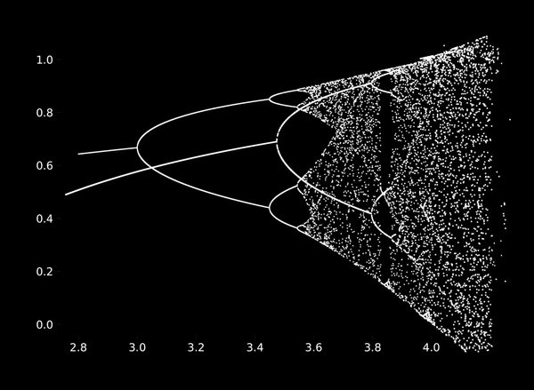
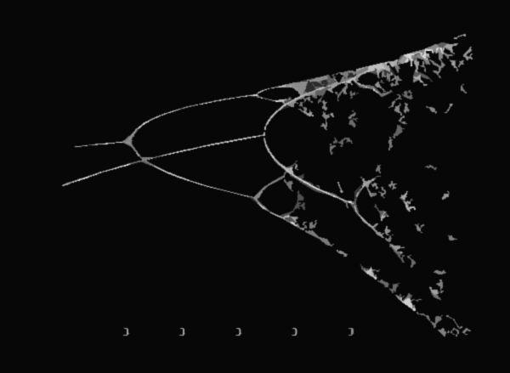

Work Presentation
Aishwarya Girish

Slide 2








My Journey So Far…

Slide 3
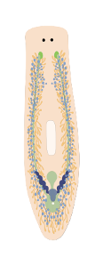

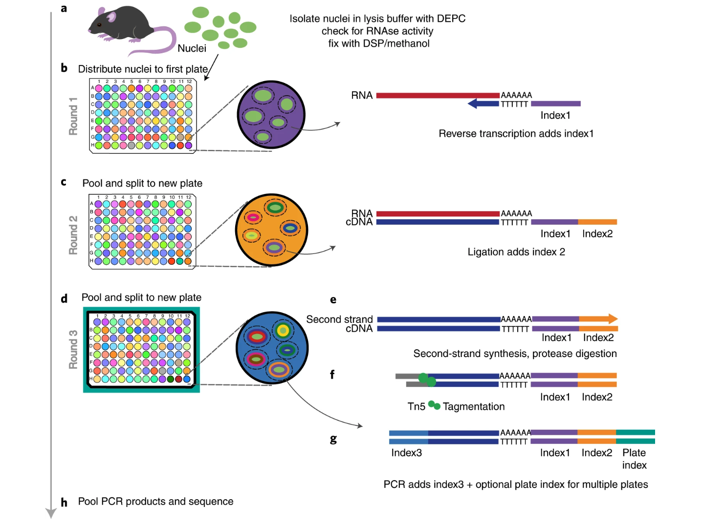
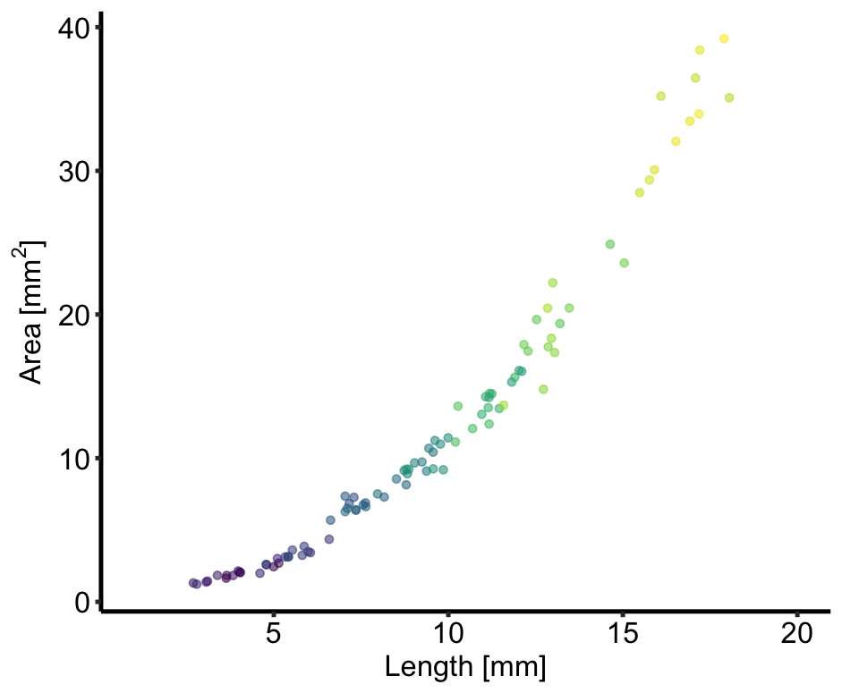
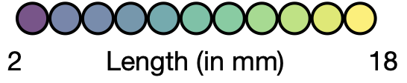
An individual resolved single-cell size atlas for P.morgani at 17.5℃
Background
1
Notes:
And in the first steps towards working out the mechanism – I started off by generating a size-atlas for Pmorgani using at the single temperature of 17.5 (where we do see a mixed population of worms) in an attempt to decouple the effects of size from temperature. The worms are flash frozen and nuclei are extracted from each single worm separately such that each well in the 96 well plate will represent an individual worm. For each worm that was used in this atlas a video was taken before freezing – so that using the same pipline I mentioned before we can easily the area and length of each worm

Slide 4
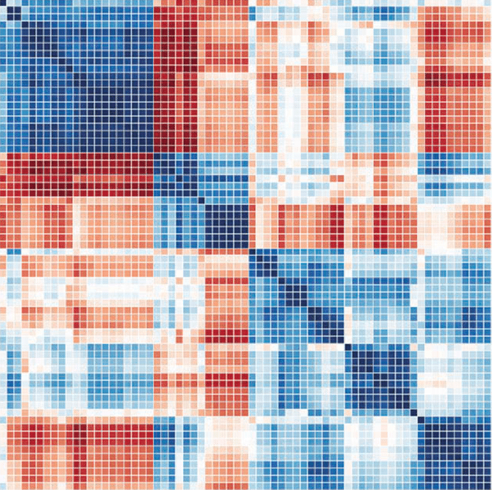
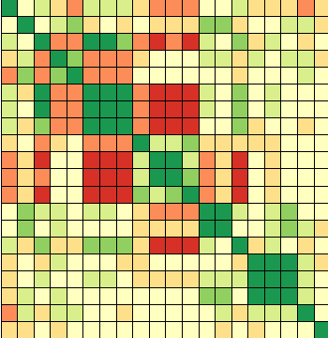
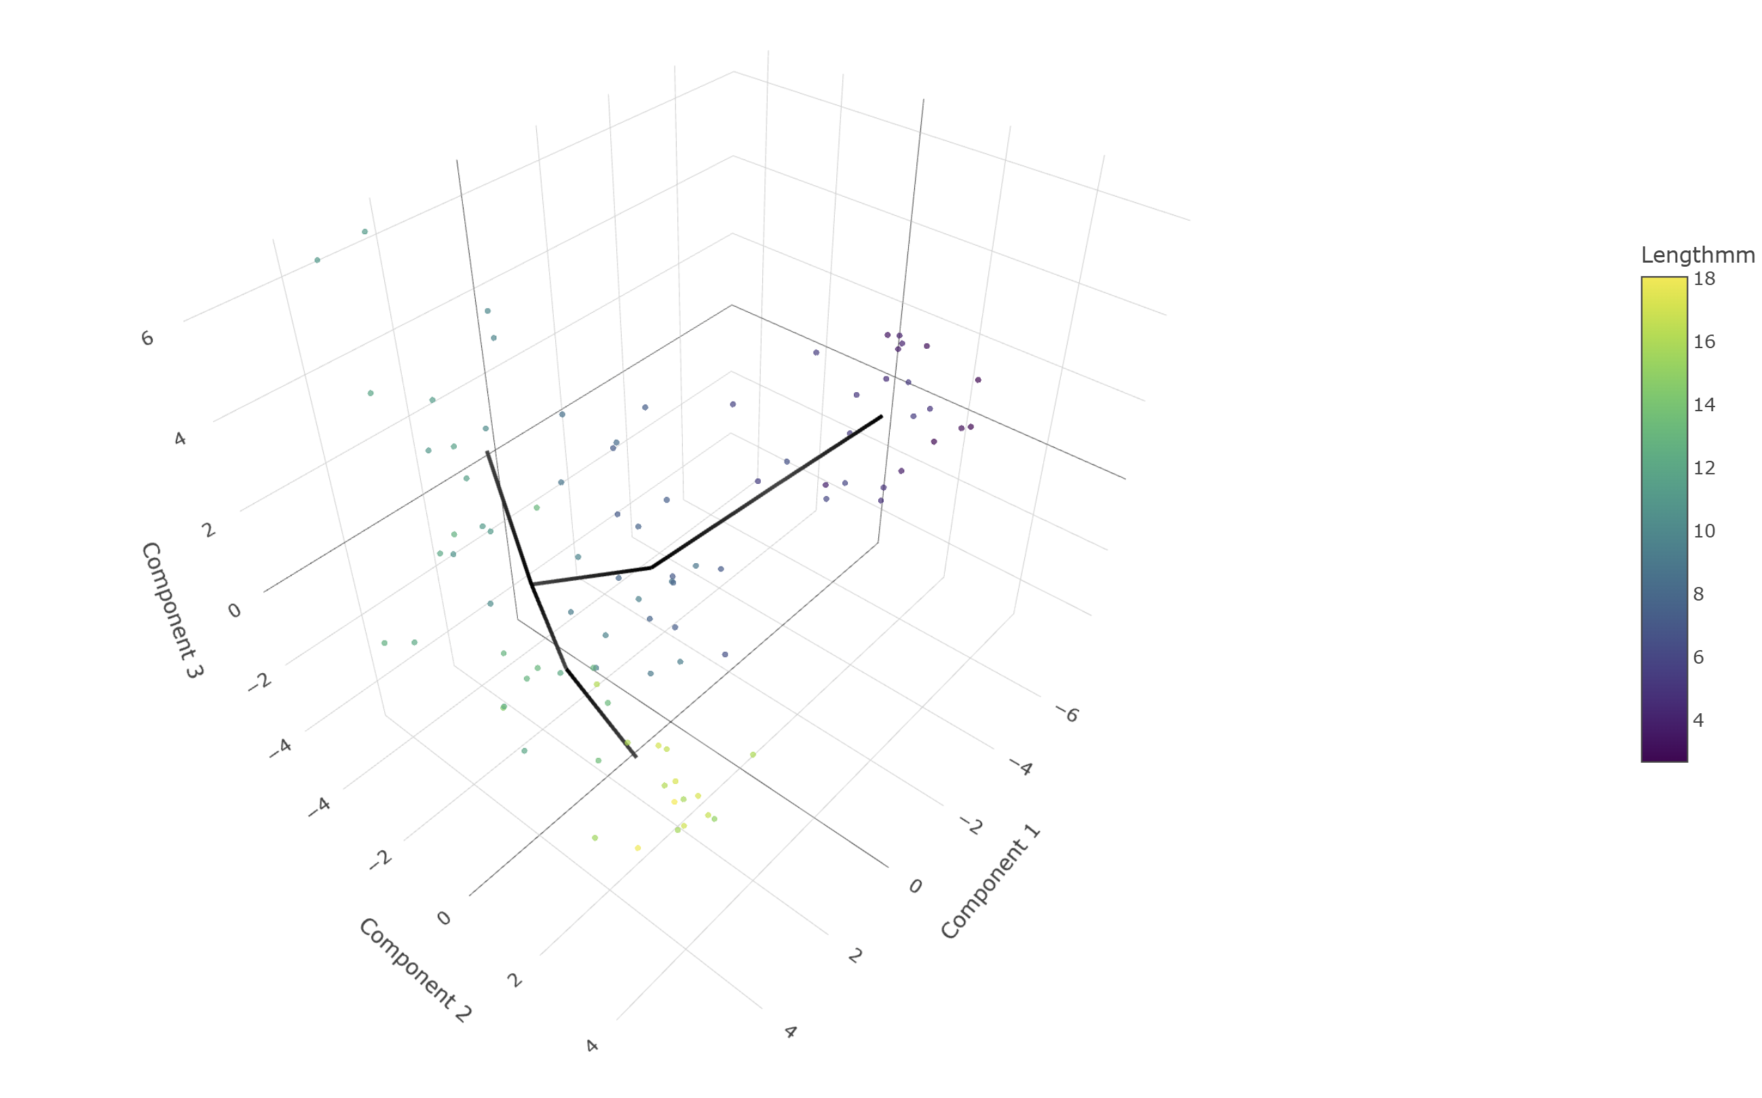
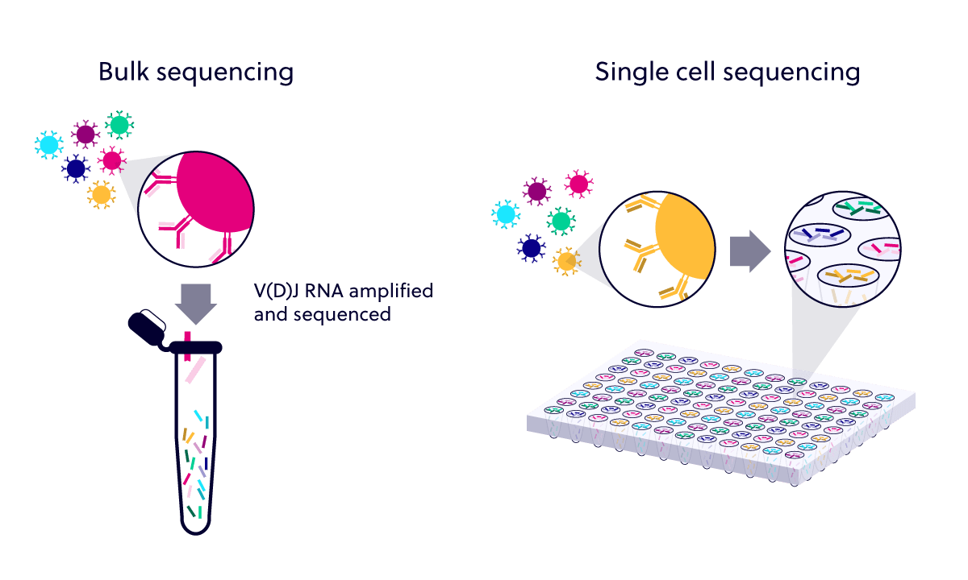

Background
Monocle3
Modelling
Classical gene-expression matrix to cell-count matrix
Single Cell Sequencing
PCA Trajectory showing an obvious bifurcation
2

Slide 5
A brief breakdown
Goal:
Quantify the number of cells of each type in each sample (e.g., worm) based on single-cell RNA-seq data
Workflow:
Start with a gene expression matrix
Monocle3
Annotate Cell Metadata
Count Cells per Sample and Cell Type
Normalize and continue further analysis
Classical gene-expression matrix to cell-count matrix
3

Slide 6
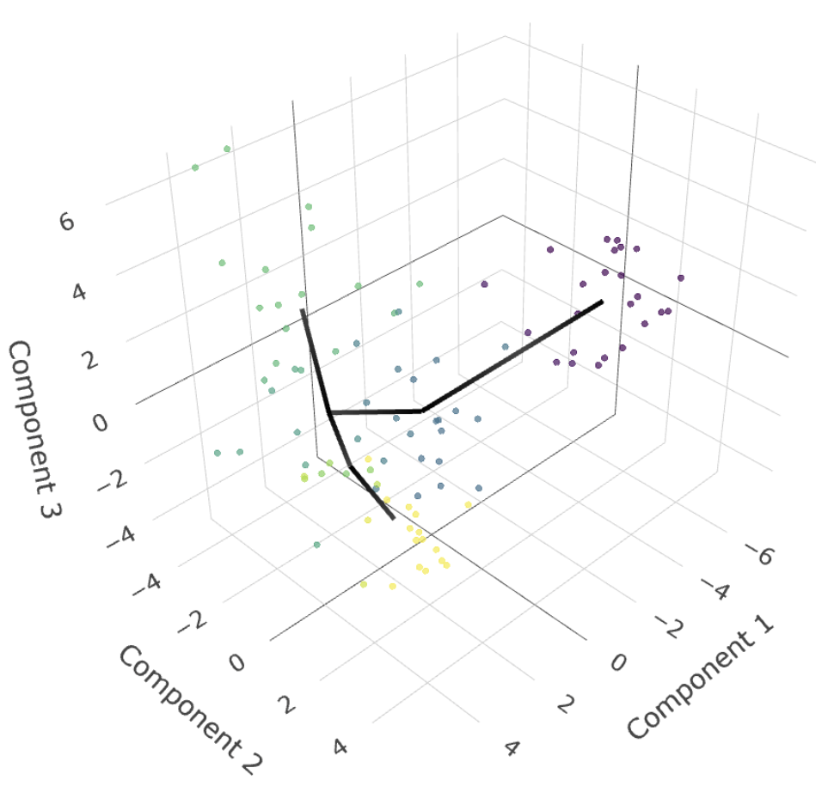
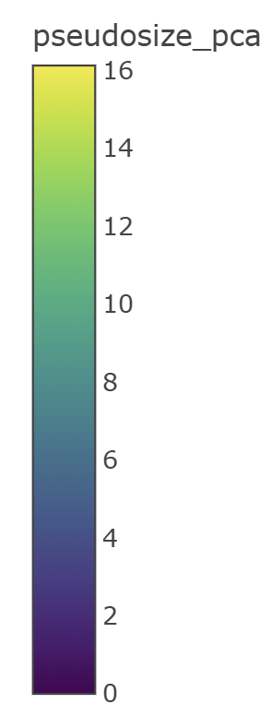
A brief breakdown
Using Monocle3, a principal graph representing the differentiation trajectory was learned with specific parameters and PCA embeddings. In planaria, the biological progression ~ correlates with physical size, so it was used as a psedotime metric.
Key Observations: Populations of committed sexual and asexual planarian samples lied on different axes of the “developmental trajectory”.
4

Slide 7






Objective
Identifying the key cell drivers
of the asexual and sexual trajectories
5

Slide 8
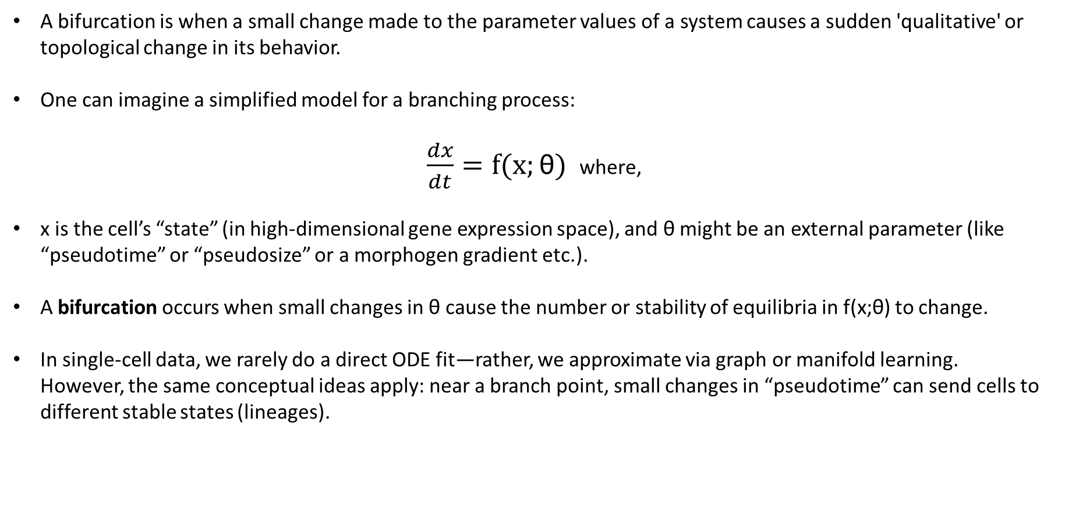
Introduction: Bifurcation
A bifurcation is when a small change made to the parameter values of a system causes a sudden 'qualitative' or topological change in its behavior.
One can imagine a simplified model for a branching process:
$\frac{dx}{dt}=f(x;\text{θ})$ where,
x is the cell’s “state” (in high-dimensional gene expression space), and θ might be an external parameter (like “pseudotime” or “pseudosize” or a morphogen gradient etc.).
A bifurcation occurs when small changes in θ cause the number or stability of equilibria in f(x;θ) to change.
In single-cell data, we rarely do a direct ODE fit—rather, we approximate via graph or manifold learning. However, the same conceptual ideas apply: near a branch point, small changes in “pseudotime” can send cells to different stable states (lineages).
6
Notes:
In a single-cell trajectory setting (such as scRNA-seq, single-cell ATAC, or even cell-count data across phenotypes), a “bifurcation” typically manifests as branching in the low-dimensional manifold or in pseudotime: cells that share a common “progenitor” state begin to diverge into two (or more) distinct lineages or fates.

Slide 9
"The Fate of a Scientist: A Bifurcation Dilemma"
"The Computational Biologist" 💻📈
Thinks biology is a just a noisy dataset.
Starts seeing everything as a probability distribution.
Can't pipette 10μL without questioning error propagation.
Y-axis (State Variable) → Scientific Sanity (x)
The middle path collapses, meaning a confused researcher must choose ONE fate.
"The Wet-Lab Biologist" 🥼🔬
Gets lost in pipetting and PCR.
Refers to math as “that thing statisticians do.”
Thinks "log" only means log-transformation of gene expression.
X-axis (Bifurcation Parameter) → Academic Stress (r)
$\frac{dx}{dt}=f(x,r)$ where, x represents scientific sanity and r is the academic stress parameter.
7

Slide 10
Analysis Pipeline
Trajectory Inference
Abundance Analysis
Combined Analysis
Monocle3 trajectory inference
Identifying local enrichment around branch points
Identifying abundance and variance transitions using differential testing
K-means clustering
Identifying branch points
Defining trajectories
Negative binomial modelling
Beta binomial modelling
PLN model for size-independent covariance
Clustering
Variance Analysis
Covariance Decompositon
8

Slide 11
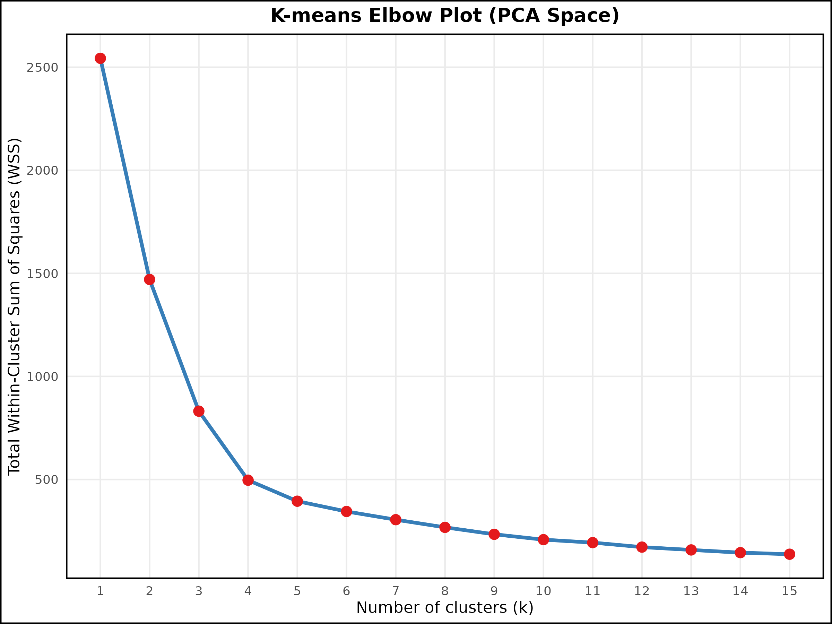
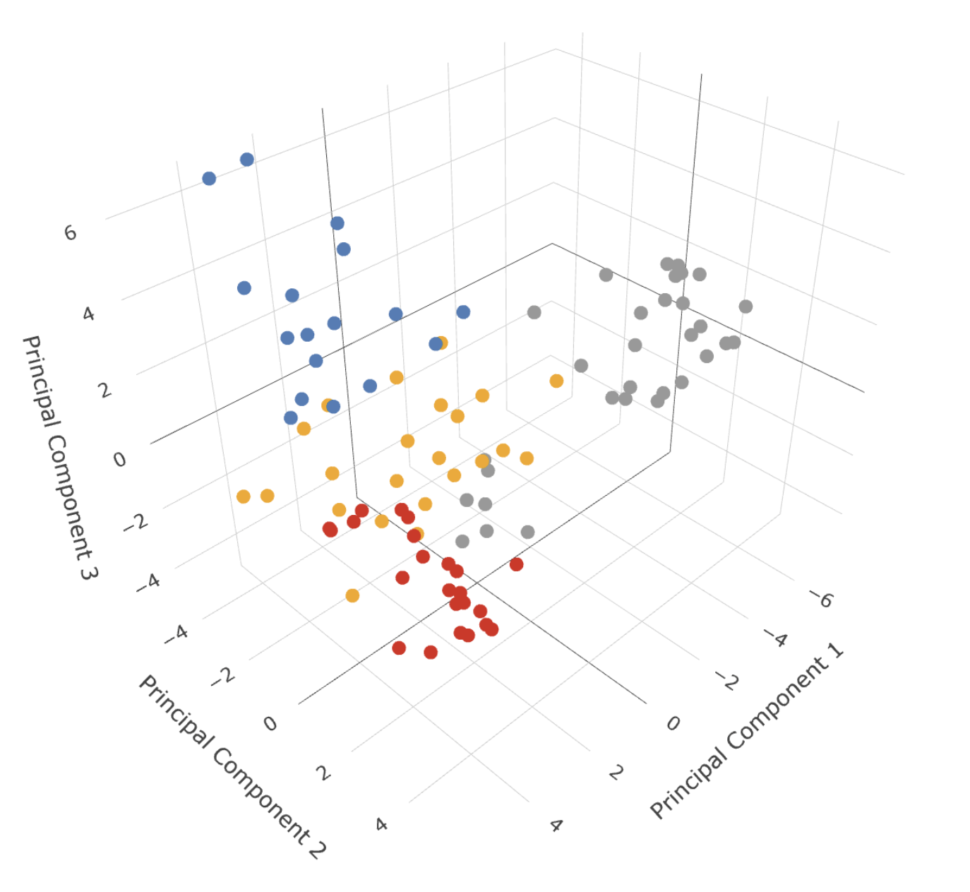
Clustering the Trajectory
An elbow plot of k-means clustering revealed four distinct clusters when using the first three principal components, which together explained 66% of the total variance.
Interestingly, including more principal components—while capturing more overall variance—led to fewer detectable clusters.
This suggests that the additional components primarily reflect noise or continuous variation rather than biologically meaningful structure.
9

Slide 12
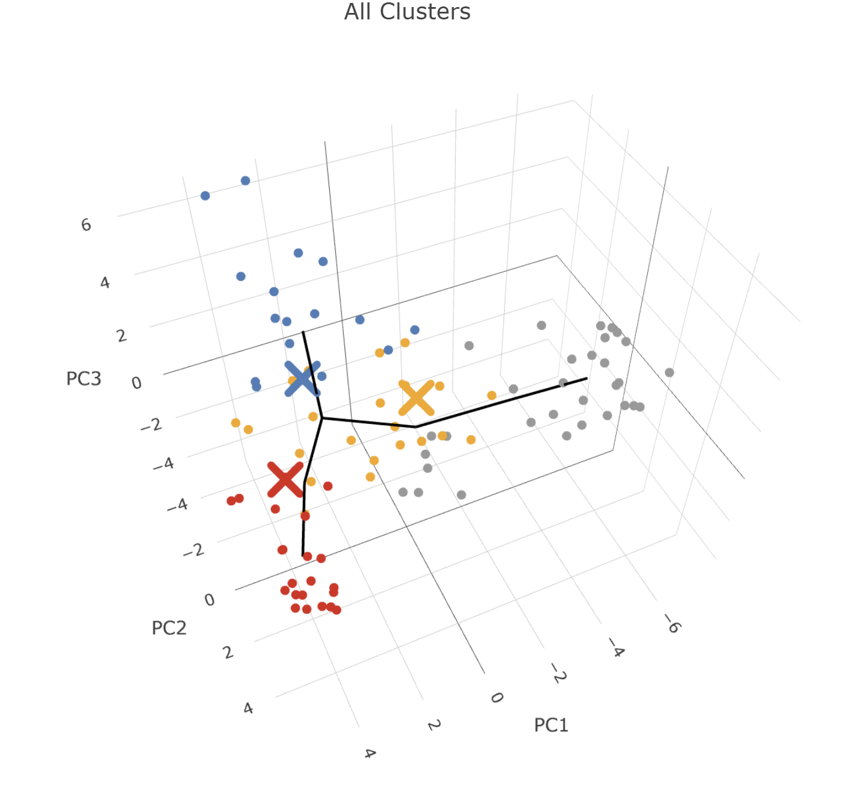
Building a meaningful perspective
Trajectory 'early_dev’ : 54 cells across clusters Prebranch_1, Prebranch_2
Trajectory 'asexual’ : 71 cells across clusters Prebranch_1, Prebranch_2, Branch_1
Trajectory 'sexual’ : 77 cells across clusters Prebranch_1, Prebranch_2, Branch_2
Trajectory 'late_dev’ : 40 cells across clusters Branch_1, Branch_2 Trajectory
The observed transitions from Prebranch to Branch clusters likely represent key developmental bifurcation points—critical moments where cells commit to either the sexual or asexual differentiation pathways.
10
Notes:
Trajectory 'early_dev' contains 54 cells across clusters: Prebranch_1, Prebranch_2 Trajectory 'asexual' contains 71 cells across clusters: Prebranch_1, Prebranch_2, Branch_1 Trajectory 'sexual' contains 77 cells across clusters: Prebranch_1, Prebranch_2, Branch_2 Trajectory 'late_dev' contains 40 cells across clusters: Branch_1, Branch_2 Trajectory 'all_clusters' contains 94 cells across clusters: Prebranch_1, Prebranch_2, Branch_1, Branch_2

Slide 13
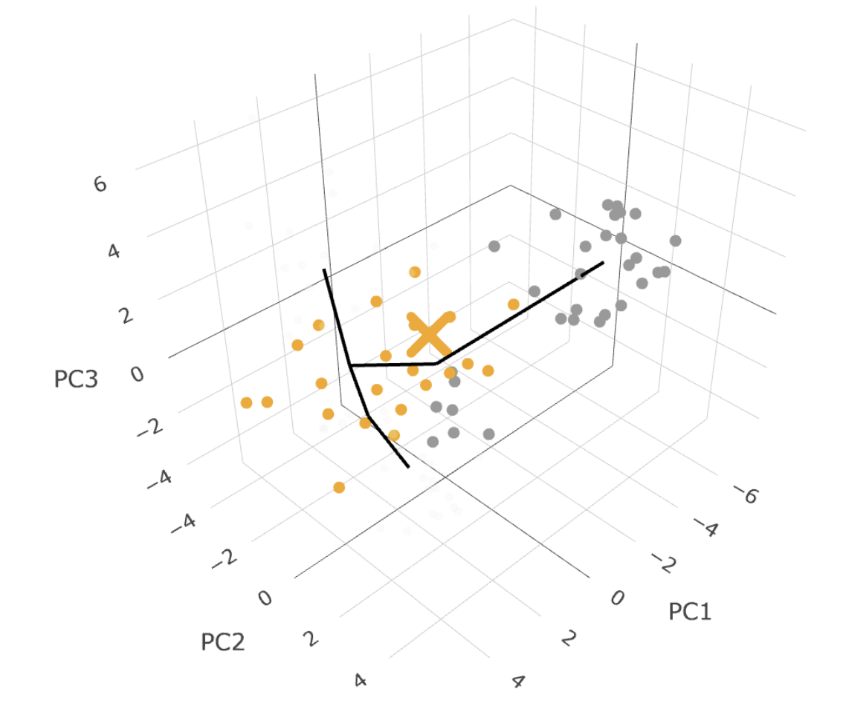
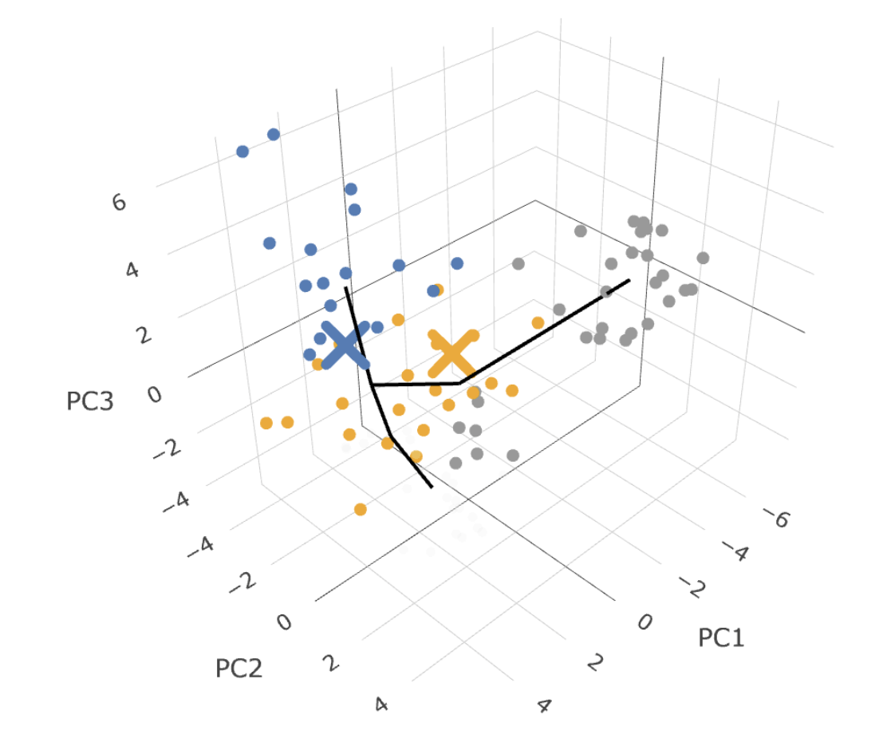
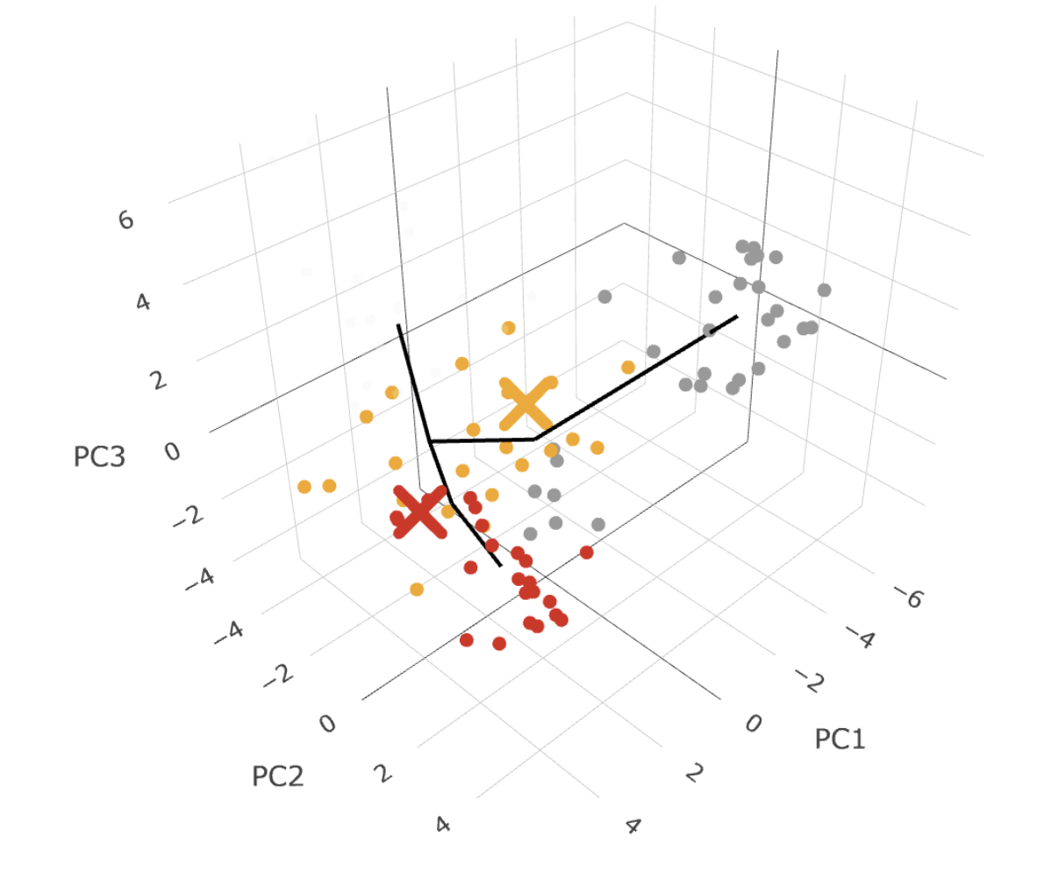
Building a meaningful perspective
Early Development Trajectory
Asexual Trajectory
Sexual Trajectory
11

Slide 14
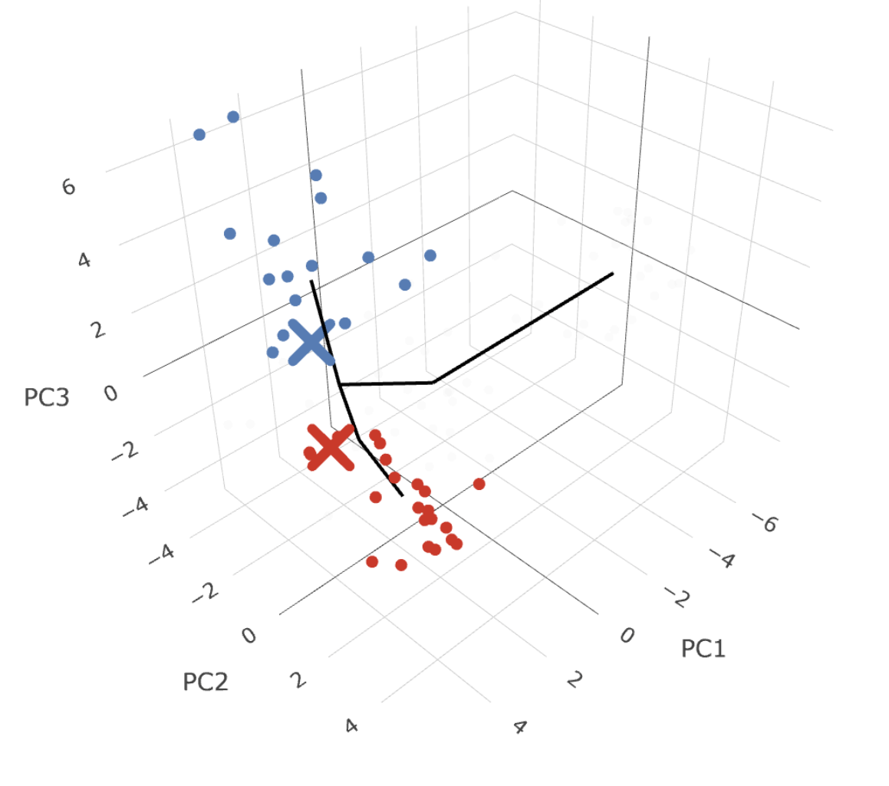
Late Sexual Trajectory
12

Slide 15
Analysis Pipeline
Trajectory Inference
Abundance Analysis
Combined Analysis
Monocle3 trajectory inference
Identifying local enrichment around branch points
Identifying abundance and variance transitions using differential testing
K-means clustering
Identifying branch points
Defining trajectories
Negative binomial modelling
Beta binomial modelling
PLN model for size-independent covariance
Clustering
Variance Analysis
Covariance Decompositon
13

Slide 16
Abundance Analysis
Objective:
Quantify how specific cell type abundances change around key pseudotime transitions within developmental trajectories. Approach:
Local Enrichment Testing: For each transition, cell type abundance within a narrow pseudotime window centered around the transition point was compared against the rest of the trajectory. This detects transient or lineage-specific expansion/contraction of cell types.
Fold-Change and Significance: Fold-changes in cell type proportions and test for significance using nonparametric Wilcoxon test (doesn’t assume normal distribution) were computed, identifying cell types that are disproportionately enriched or depleted near branch points.
Visualizing Cell Type Dynamics: Smoothed abundance trajectories highlight which cell types change gradually or sharply in response to developmental decisions.
Biological Implications:
This graph will show which cell types are starting to rise or fall in abundance right at the early transition point. It helps identify early fate biases or early regulators that appear before full commitment to either branch.
14
Notes:
Let’s say we have two independent samples:
Group 1: X1,X2,…,XmX_1, X_2, \dots, X_mX1​,X2​,…,Xm​ (size mmm)
Group 2: Y1,Y2,…,YnY_1, Y_2, \dots, Y_nY1​,Y2​,…,Yn​ (size nnn)
1. Combine the two groups and rank all observations from smallest to largest, assigning average ranks in case of ties.
2. Compute the test statistic:
One common form is the Wilcoxon rank-sum statistic (W):
W=∑i=1mR(Xi)W = \sum_{i=1}^{m} R(X_i)W=i=1∑m​R(Xi​) Where R(Xi)R(X_i)R(Xi​) is the rank of the iii-th observation from Group 1.
Alternatively, you can compute the Mann–Whitney U statistic, which is related:
U=W−m(m+1)2U = W - \frac{m(m+1)}{2}U=W−2m(m+1)​ 3. Under the null hypothesis (i.e., both groups are from the same distribution), the distribution of UUU is known, and we can compute a p-value (either from exact distribution or normal approximation).
📐 Normal Approximation (for large samples)
If both mmm and nnn are large (typically ≥10), the distribution of UUU approximates a normal distribution with:
Mean:
μU=mn2\mu_U = \frac{mn}{2}μU​=2mn​ Standard deviation:
σU=mn(m+n+1)12\sigma_U = \sqrt{\frac{mn(m+n+1)}{12}}σU​=12mn(m+n+1)​​ Then the z-score is:
z=U−μUσUz = \frac{U - \mu_U}{\sigma_U}z=σU​U−μU​​ This z-score can be used to compute the p-value.

Slide 17
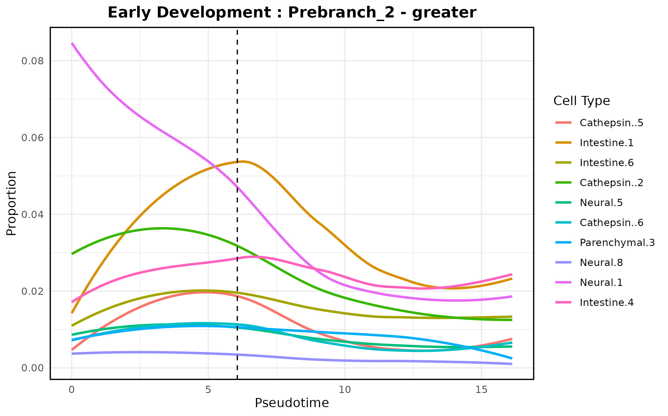
Abundance Analysis
15
Notes:
Key Developmental Insights:
Early Lineage Priming:
The trajectory begins with Cathepsin+ cells (5, 2, 6) suggesting:
Lysosomal activation is an early event in differentiation
Tissue remodeling capacity is established before fate commitment
May represent a "clearing phase" to reset cellular state
Intestinal Primordium Formation:
Subsequent appearance of Intestine 1/4/6 indicates:
Gut lineage specification occurs early
Multiple intestinal subtypes emerge simultaneously (not linear progression)
Suggests a "saltatory" differentiation pattern with parallel branches
Neural Development Timing:
Neural 1/5/8 appear later than intestinal cells, implying:
Neurogenesis occurs after gut specification
Distinct neural subtypes (5 vs 8) emerge together (fate bifurcation)
Neural 1 may represent neural progenitors
Parenchymal Niche:
Parenchymal 3 positioning suggests:
Mesenchymal support cells differentiate alongside epithelial/neural types
May provide trophic support for other lineages

Slide 18
Abundance Analysis (Biological Implications)
Wilcoxon enrichment near Prebranch_2 indicates a local increase in specific cell types around the bifurcation point.
Despite this local peak, overall abundance may decline across pseudotime.
Transient Populations: These cell types may represent early progenitor or transitional states that are temporarily enriched before cells commit to a lineage.
Fate Commitment: As cells progress beyond Prebranch_2 toward Branch_1 or Branch_2, the proportion of early cell types declines, reflecting differentiation or fate restriction.
Developmental Dynamics: This pattern is common in development, where cells briefly accumulate in an intermediate state before exiting toward specialized fates.
16
Notes:
What If Abundance Goes Down?
A decrease in abundance near a branch point suggests:
Exit or depletion from a previous state (e.g., loss of progenitor identity).
Cells are committing to a new fate and no longer express the features of the depleted cell type.
The cell type may be actively excluded from the new trajectory (e.g., not involved in downstream fate decisions).

Slide 19
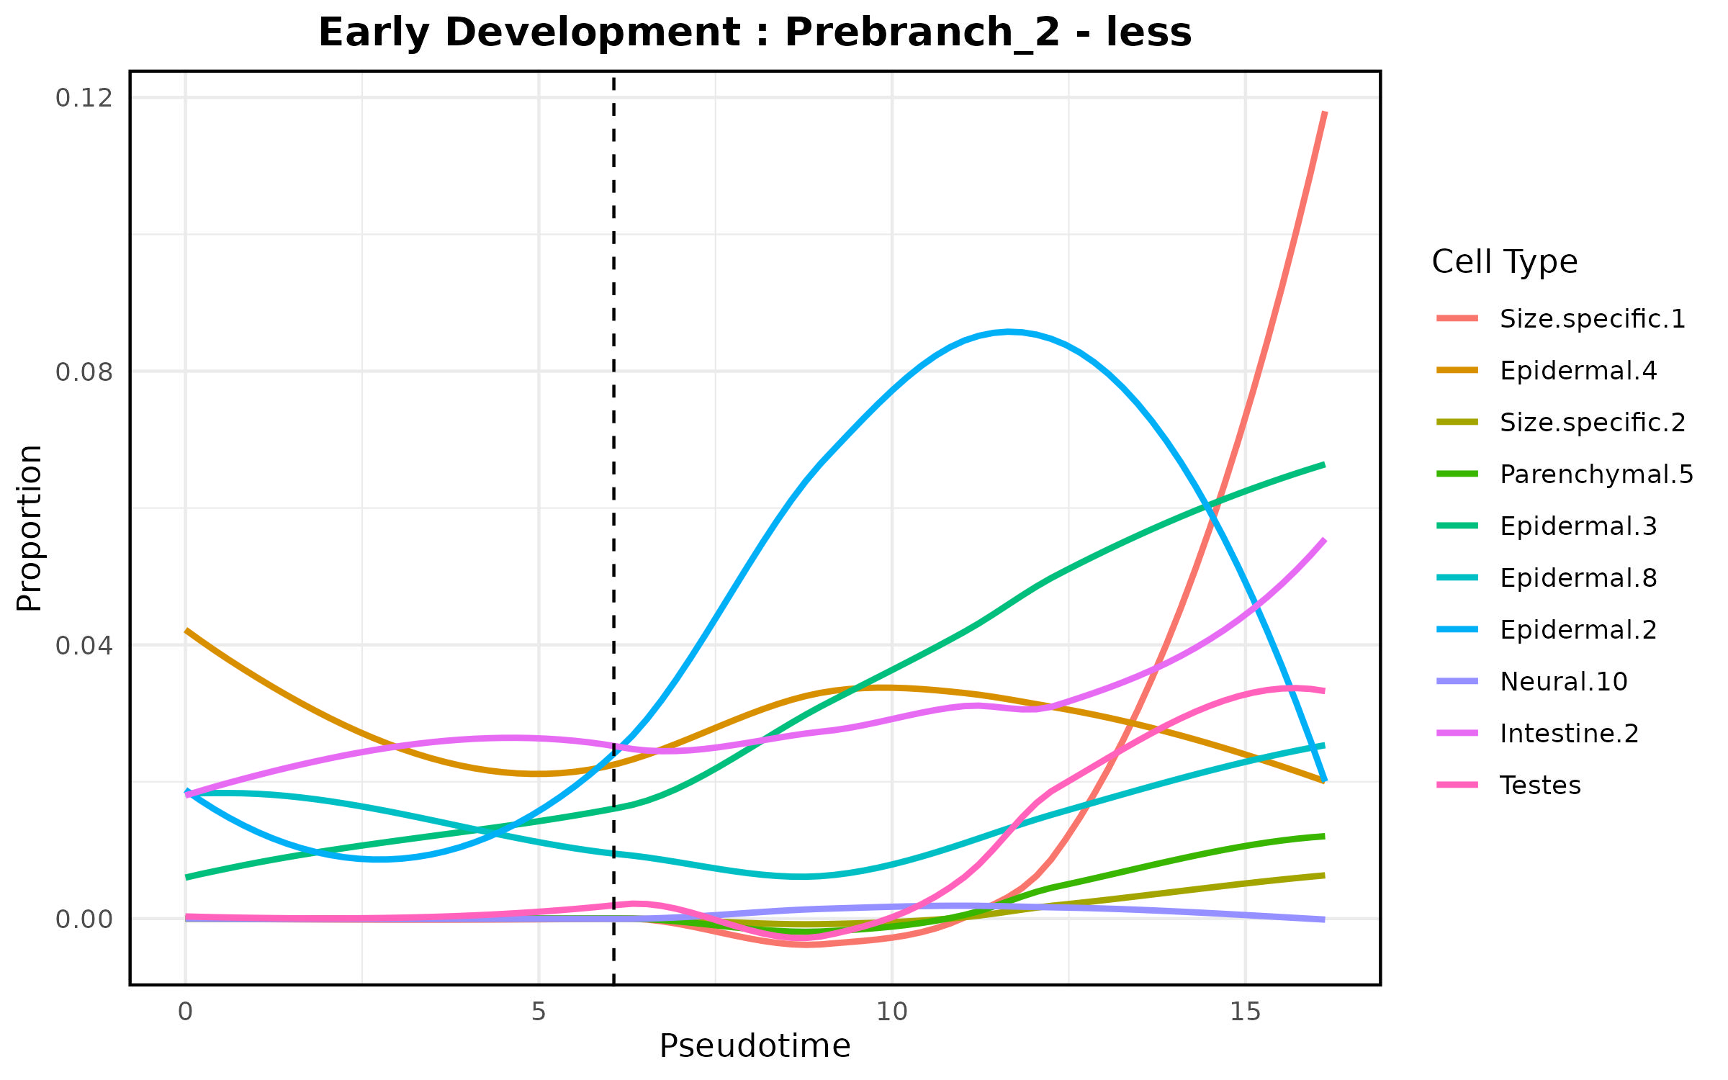
Abundance Analysis
17

Slide 20
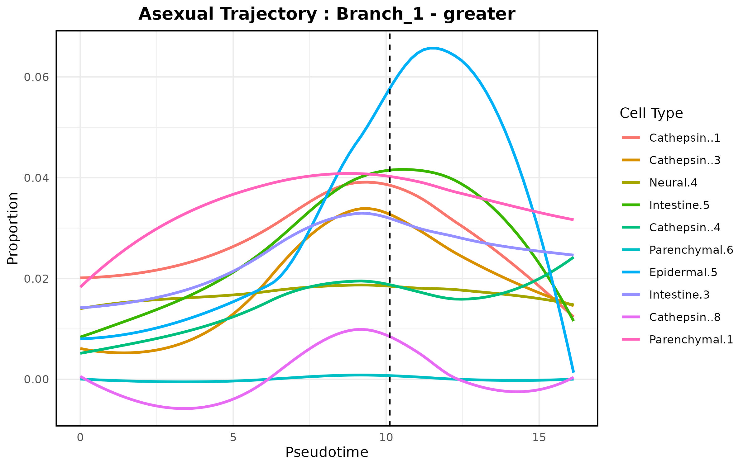
Abundance Analysis
18
Notes:
Asexual-Specific Developmental Program
Lysosomal Dominance (Cathepsin+ Cells: 1,3,4,8)
Function: Tissue remodeling for fission preparation
Evidence:
4/10 cell types are Cathepsin+
Includes both high-activity (Cathepsin+1/3) and rare subtypes (+8)
Implication:
Asexual reproduction requires extensive protein turnover for:
Wound healing after fission
Resource recycling for rapid regeneration
Delayed Neural Commitment (Neural 4 only)
Pattern: Single neural subtype appears early
Contrast: Sexual trajectories typically show more neural diversity
Purpose: May represent:
Minimal nervous system maintenance during fission
Sensory neurons for fission plane orientation
Gut-Mesoderm Coordination (Intestine 5/3 + Parenchymal 6/1)
Observation:
Intestinal and parenchymal cells interleaved
Parenchymal 6 (inactive) → Parenchymal 1 (active)
Role:
Metabolic support for blastema formation
Parenchymal 1 likely secretes growth factors (FGFs/Wnts)
Epidermal Latecomer (Epidermal 5)
Positioning: Appears after internal tissues
Significance:
Outer covering forms last
Specialized for fission plane closure

Slide 21
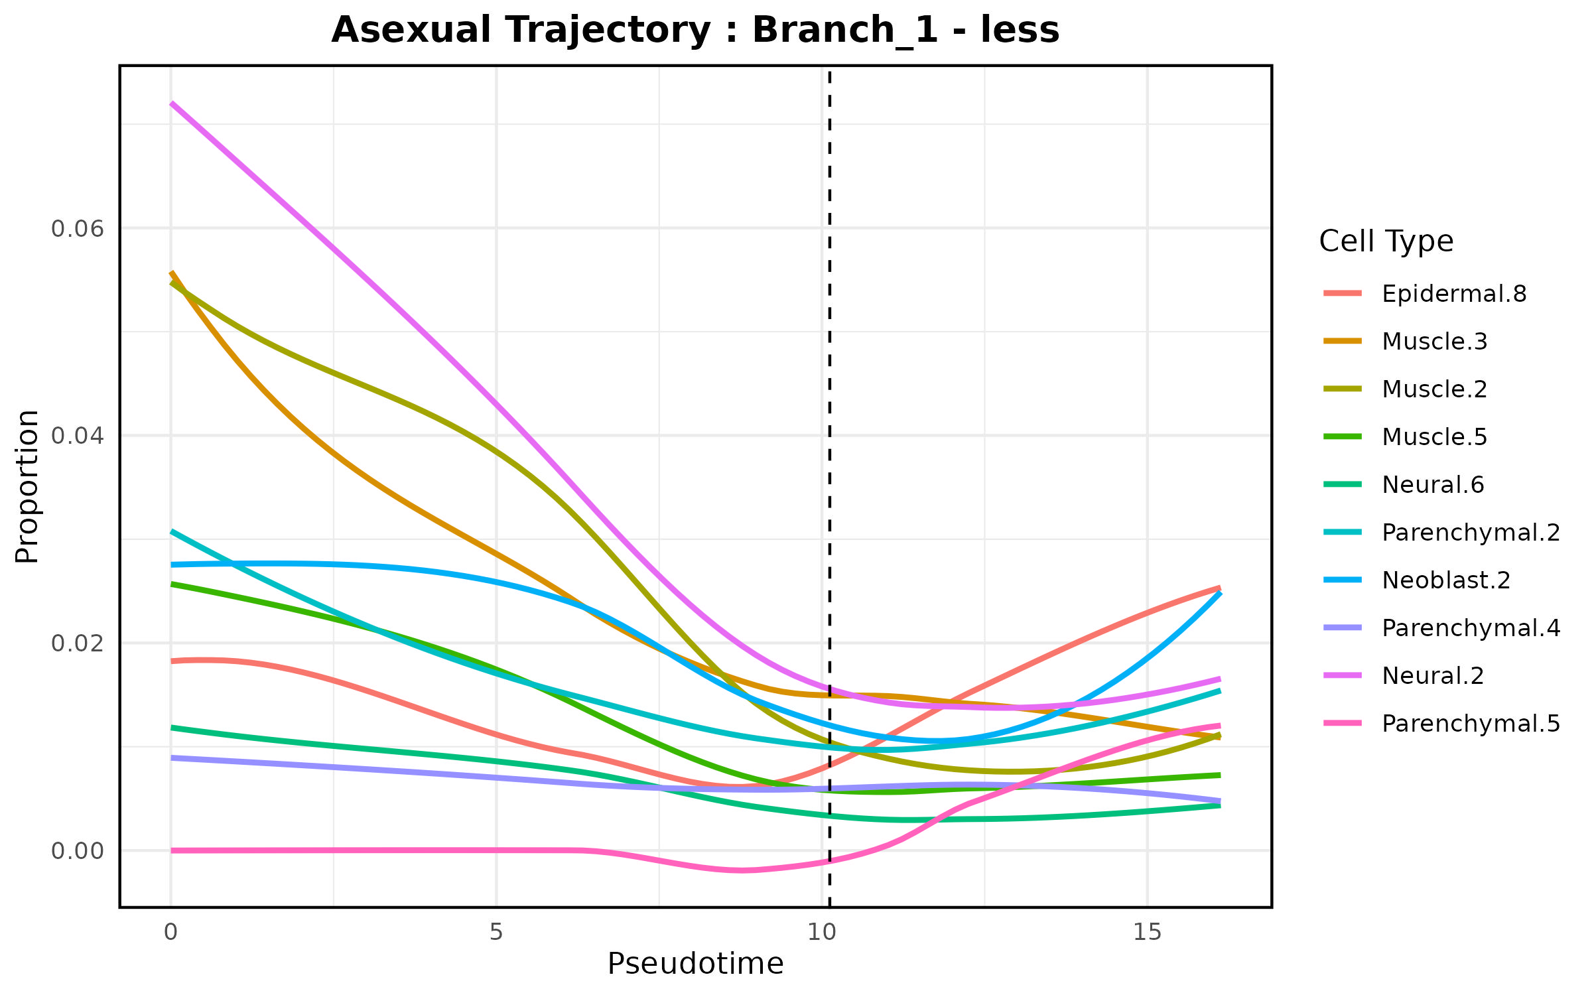
Abundance Analysis
19

Slide 22
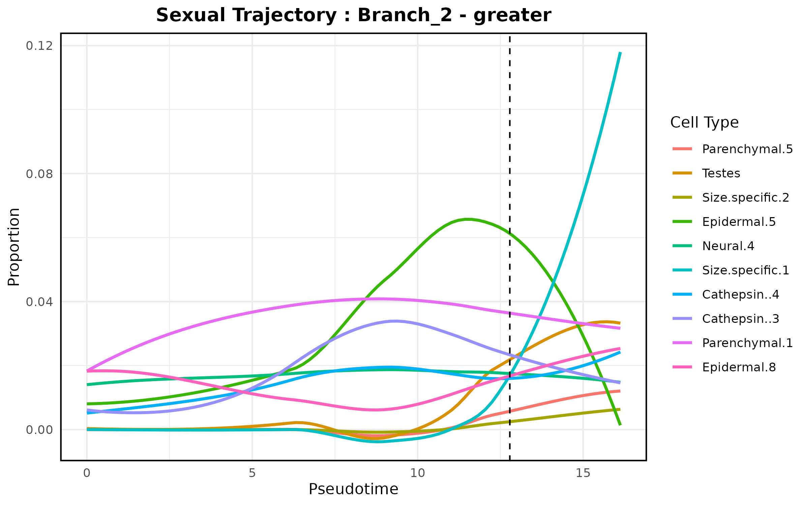
Abundance Analysis
20
Notes:
Sexual-Specific Developmental Signature
Germline Priming (Early Testes Appearance)
Position: 2nd in trajectory after Parenchymal.5
Implications:
Sexual fate commitment occurs very early
Requires niche establishment (Parenchymal.5 likely creates gonadal microenvironment)
Testes development precedes somatic specialization
Size-Regulated Checkpoints (Size.specific.1/2)
Pattern: Interspersed with somatic cell types
Function:
Size.specific.1 may monitor body size/age thresholds for sexual maturity
Size.specific.2 could regulate gonad growth scaling
Neural-Gonadal Coordination (Neural.4)
Position: Adjacent to Testes in trajectory
Potential Role:
May provide neuroendocrine signals for gametogenesis
Could coordinate reproductive behavior (mating neurons)
Cathepsin Wave (Late Cathepsin.3/4)
Timing: After germline commitment
Purpose:
Sperm packaging (removing excess cytoplasm)
Follicle remodeling during oogenesis
Contrasts with asexual trajectory where Cathepsin+ appear early
Epidermal Specialization (Epidermal.5/8)
Key Features:
Epidermal.5: May form genital pore epithelium
Epidermal.8 (late): Potentially secretes mating pheromones
FeatureSexual TrajectoryAsexual Trajectory GermlineEarly Testes commitmentAbsent Size RegulationExplicit checkpoints (Size.spec)Body size-independentCathepsin TimingLate (gametogenesis)Early (fission preparation)Neural TypesReproductive neuroendocrineMinimal maintenance

Slide 23
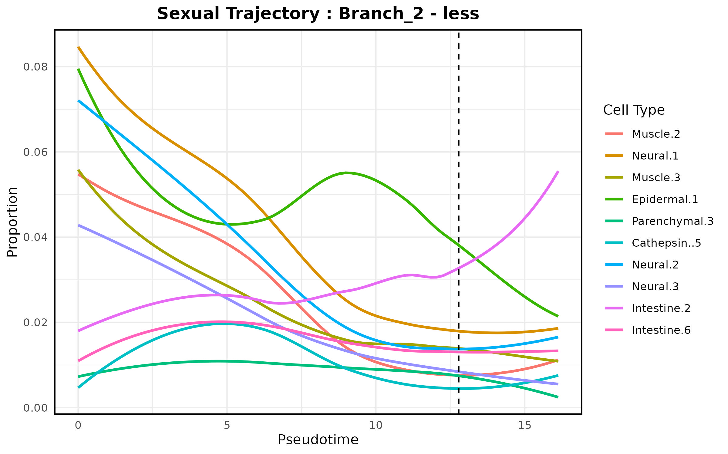
Abundance Analysis
21

Slide 24
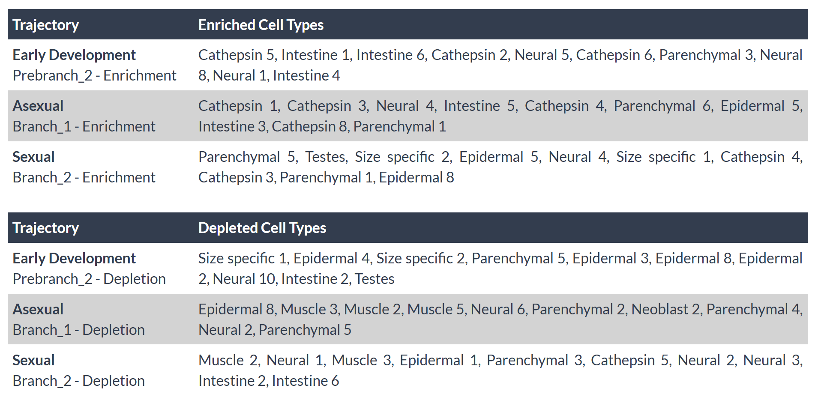
Abundance Analysis
22

Slide 25
Analysis Pipeline
Trajectory Inference
Abundance Analysis
Combined Analysis
Monocle3 trajectory inference
Identifying local enrichment around branch points
Identifying abundance and variance transitions using differential testing
K-means clustering
Identifying branch points
Defining trajectories
Negative binomial modelling
Beta binomial modelling
PLN model for size-independent covariance
Clustering
Variance Analysis
Covariance Decompositon
23

Slide 26
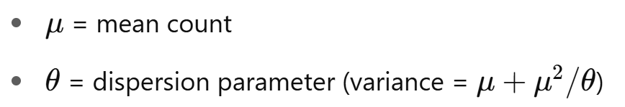
Negative Binomial Modelling of Variance
Mathematically: Counts Y∼ NB(μ, θ), where
Accounts for overdispersion by allowing variance > mean.
Provides realistic confidence intervals reflecting biological spread, not just mean uncertainty.
Enables simulation of possible count distributions at each pseudotime point.
Questions we want to answer:
Is the variance itself changing over time?
Is the variability expected under a null model of size/pseudotime?
Are certain branches more tightly controlled?
Do rare cell types show more stochastic behavior?
24

Slide 27
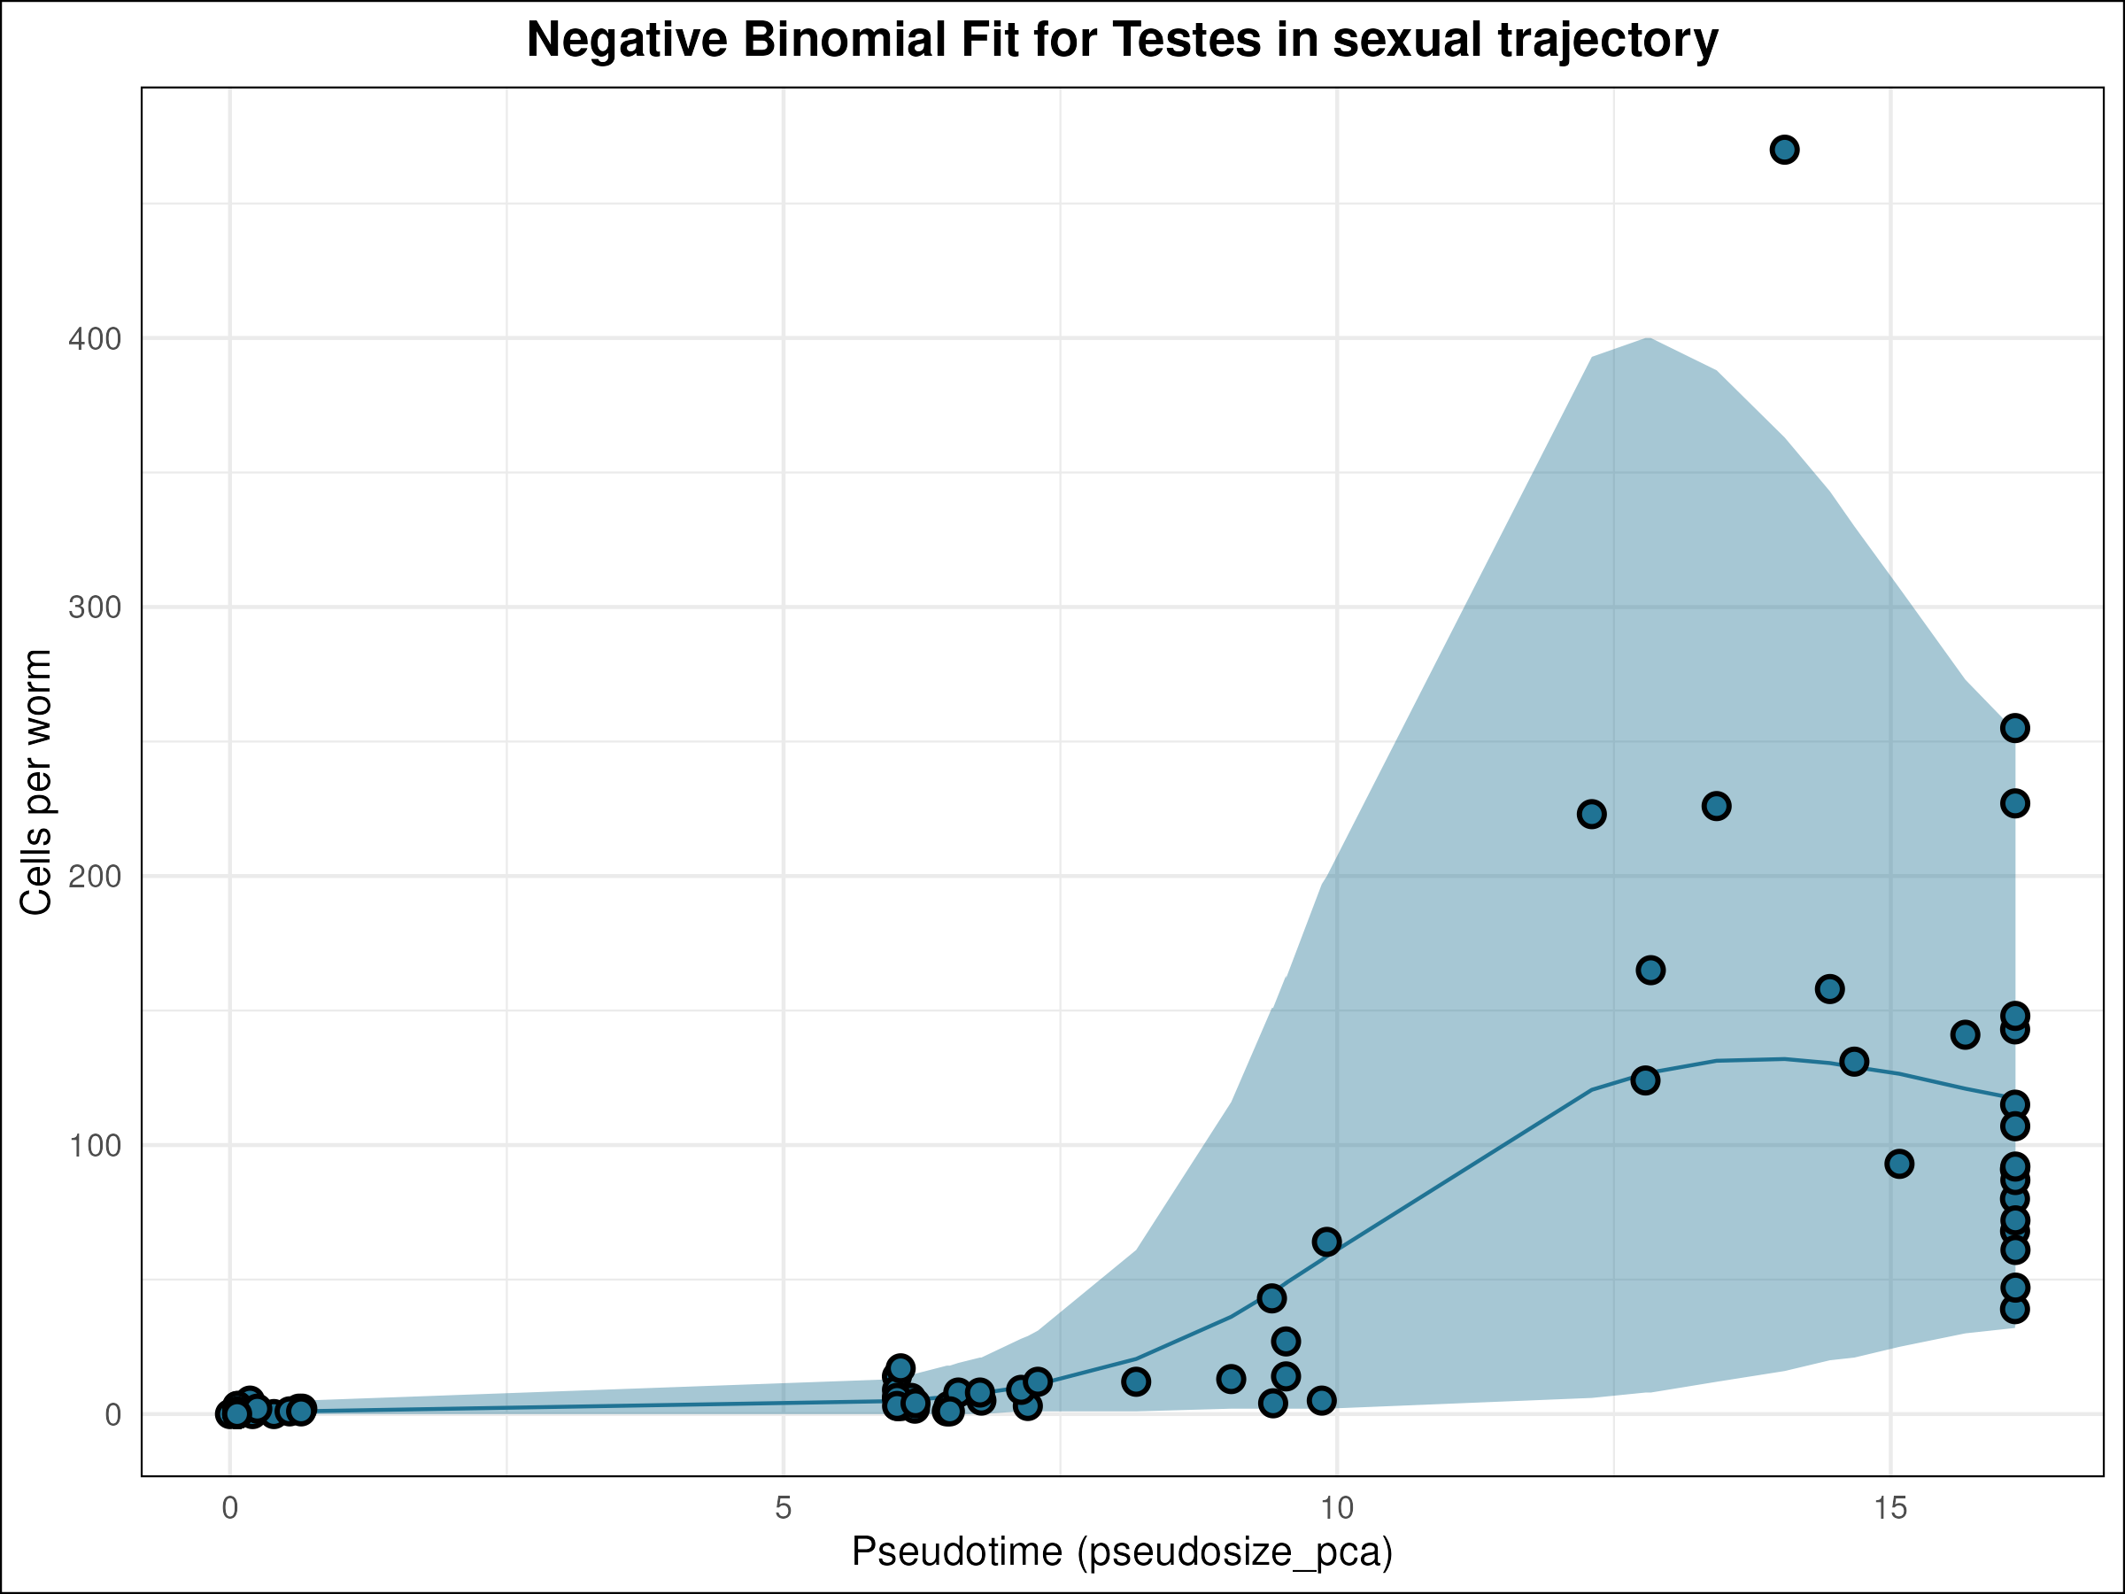
Negative Binomial Fits
25

Slide 28
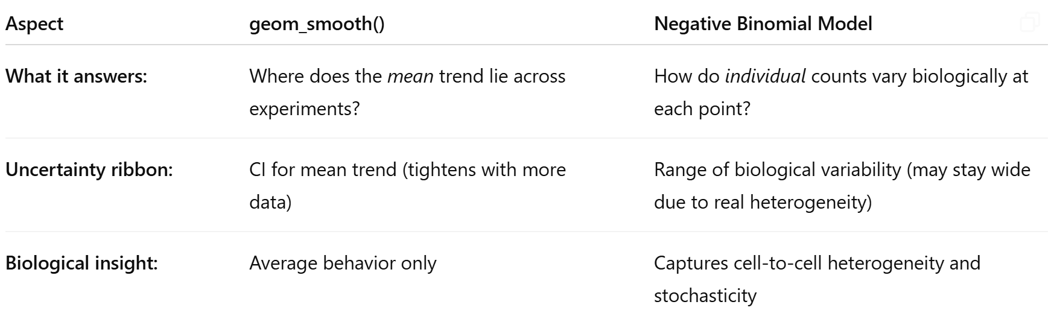
Bringing more clarity
26

Slide 29
Analysis Pipeline
Trajectory Inference
Abundance Analysis
Combined Analysis
Monocle3 trajectory inference
Identifying local enrichment around branch points
Identifying abundance and variance transitions using differential testing
K-means clustering
Identifying branch points
Defining trajectories
Negative binomial modelling
Beta binomial modelling
PLN model for size-independent covariance
Clustering
Variance Analysis
Covariance Decompositon
27

Slide 30
A Combined Analysis
Basis of the Statistical Inference
Mean Fold Change (log₂FC): Quantifies relative enrichment or depletion of each cell type near the branch point.
Variance Fold Change (log₂FC): Captures changes in variability — i.e., how heterogeneous cell type abundance becomes at the transition.
Significance (p_sum): Combined -log₁₀(p) from:
Wilcoxon test (mean difference)
Levene’s test (variance difference)
Biological Significance
Enrichment Near Bifurcation: Peaks in mean abundance suggest transient accumulation of specific cell types — potentially progenitor or decision-making states.
Variance Changes: Increased variability may indicate fate plasticity or asynchronous transitions among individual cells.
Key Insight: This method helps isolate cell types that are functionally or regulatory important during developmental branching, revealing transitional states and lineage commitment events in planarian development.
28

Slide 31
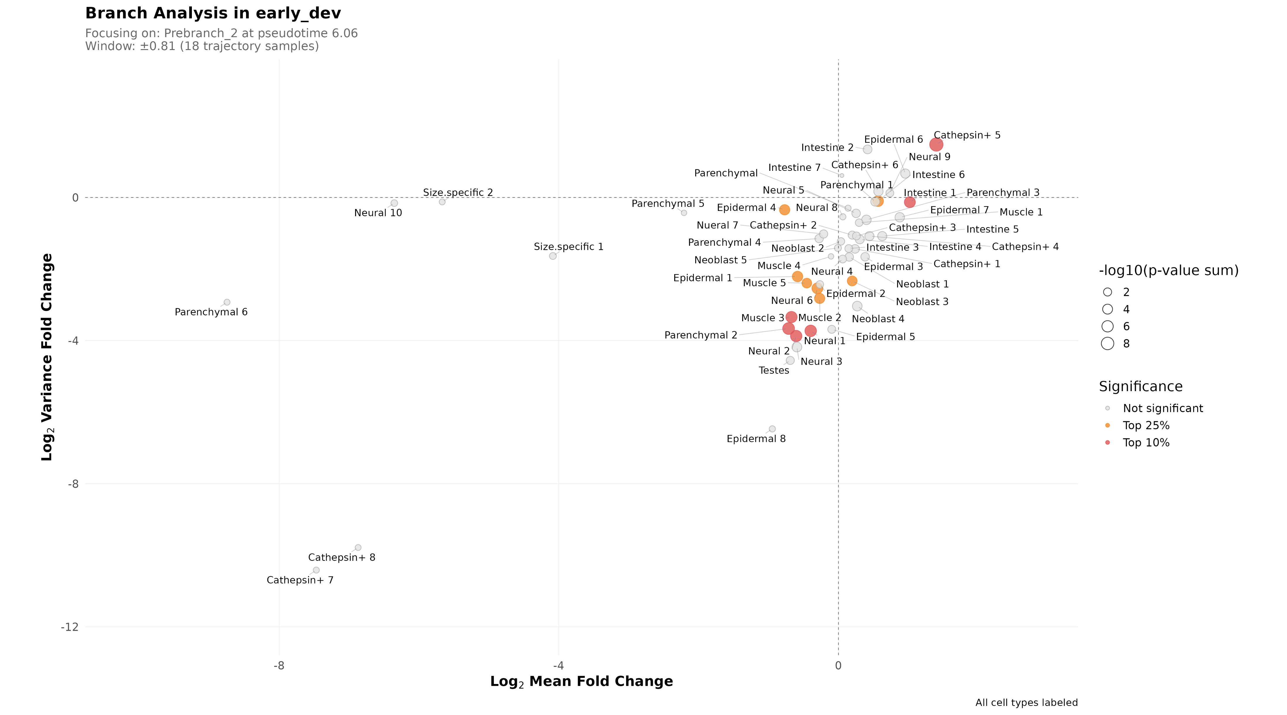
29

Slide 32
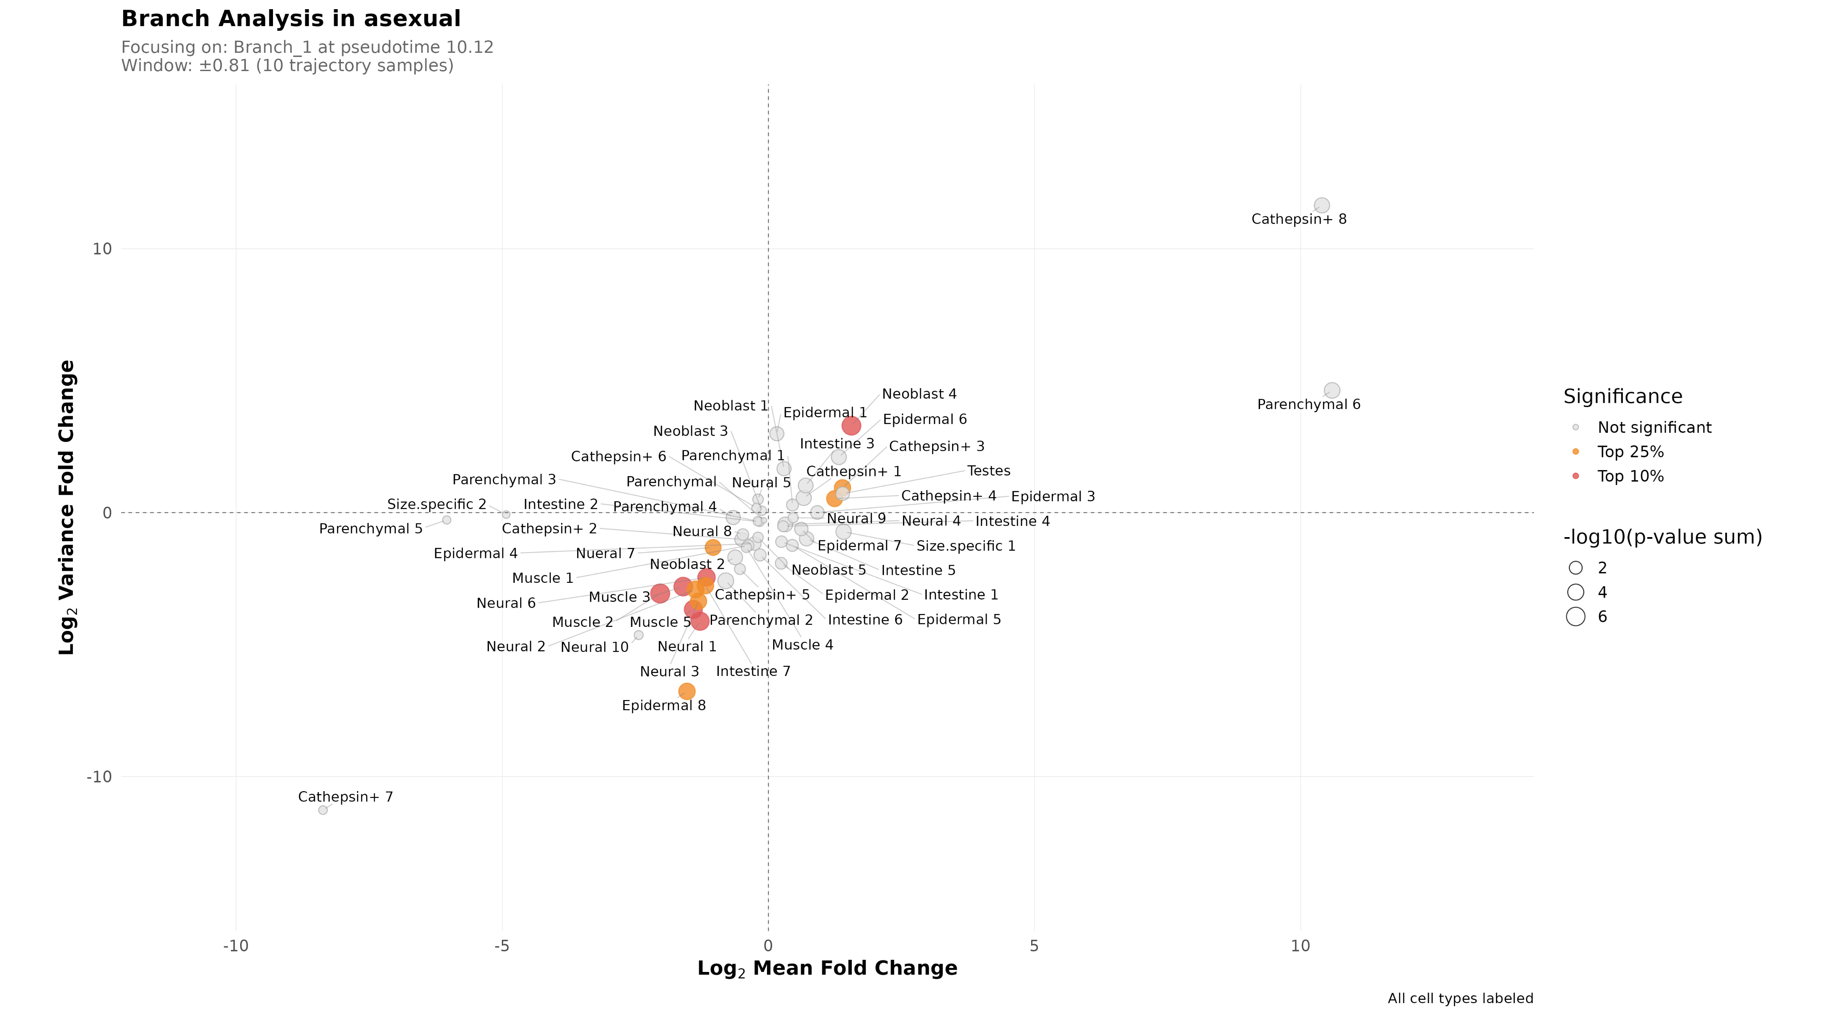
30

Slide 33
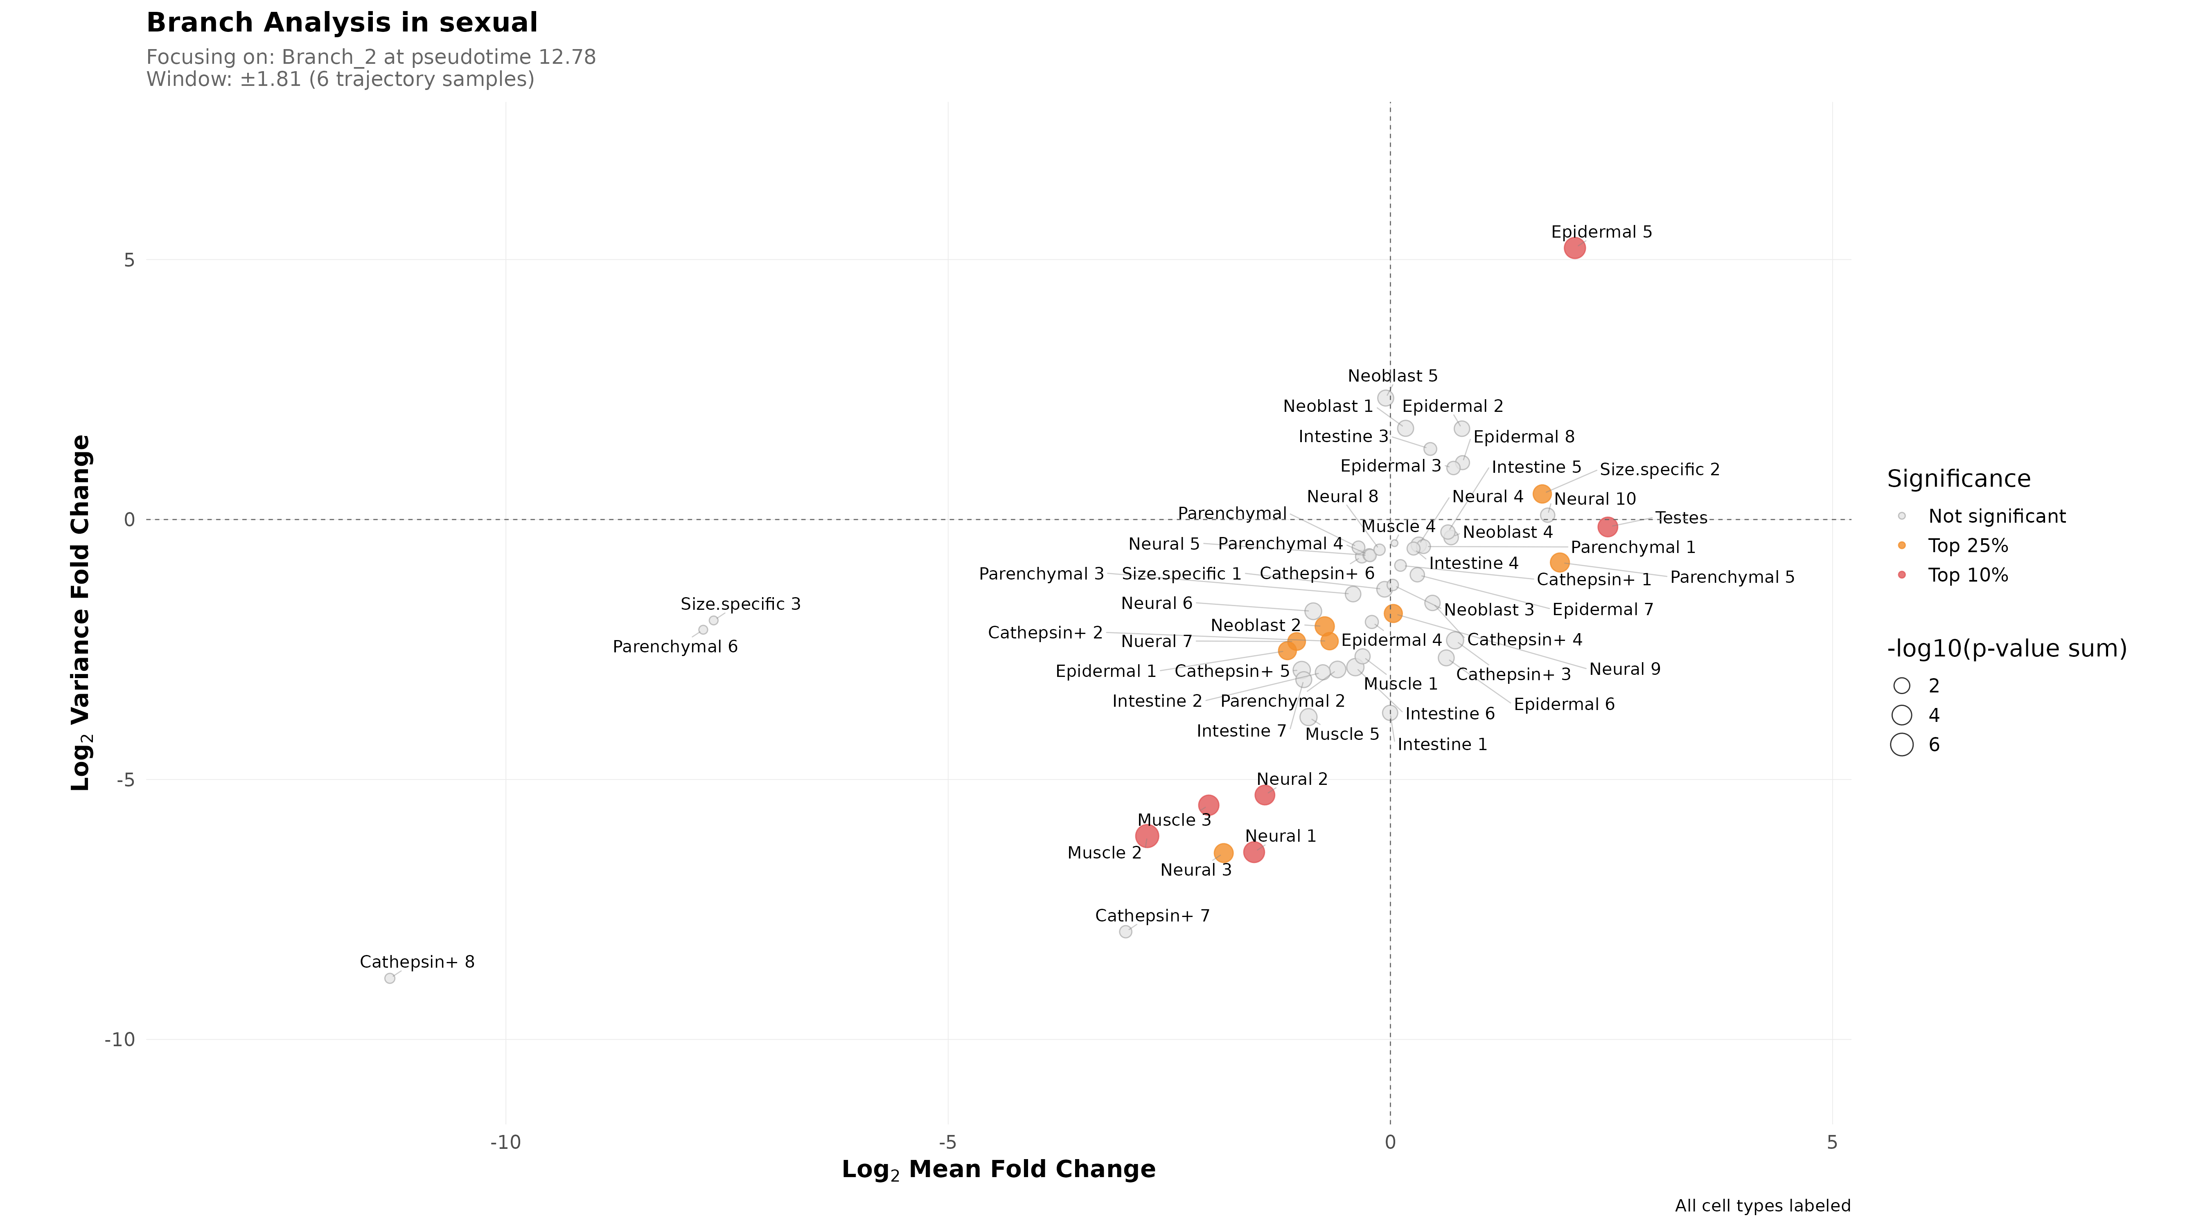
31

Slide 34
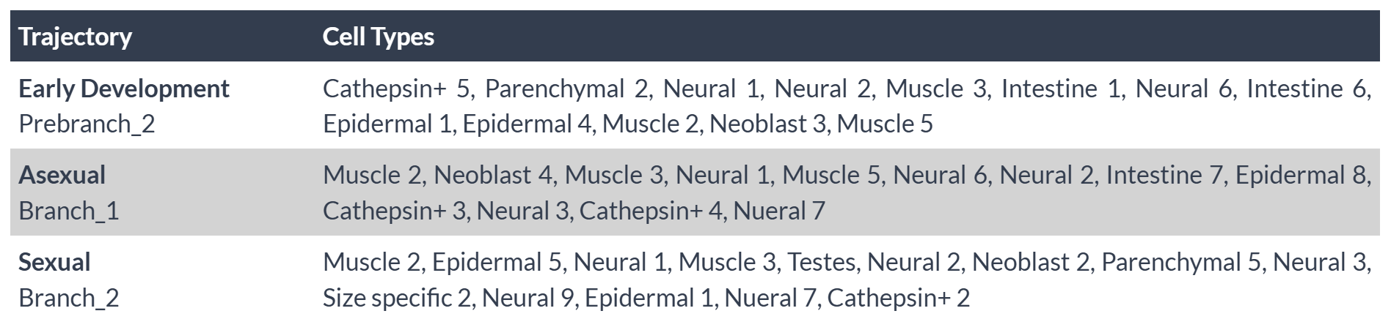
A Combined Analysis
32

Slide 35
Analysis Pipeline
Trajectory Inference
Abundance Analysis
Combined Analysis
Monocle3 trajectory inference
Identifying local enrichment around branch points
Identifying abundance and variance transitions using differential testing
K-means clustering
Identifying branch points
Defining trajectories
Negative binomial modelling
Beta binomial modelling
PLN model for size-independent covariance
Clustering
Variance Analysis
Covariance Decompositon
33

Slide 36
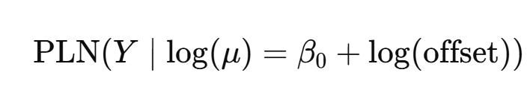
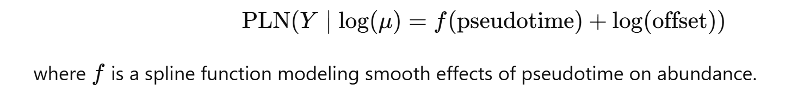
PLN Models for studying cell type covariance
Background:
To understand coordination among cell types during the planarian growth trajectory, we model the cell type abundance matrix using a Poisson Lognormal (PLN) framework. Samples are ordered by a pseudotime (size) variable, representing regenerative progression.
Statistical Framework
We fit two models:
Total Covariance: Captures all sources of covariation across samples.
Size-Adjusted Covariance:
From this:
Size-Dependent Covariance: Covariance of fitted values (explained by pseudotime).
Size-Independent Covariance: Residual covariance (after regressing out pseudotime effects).
34

Slide 37
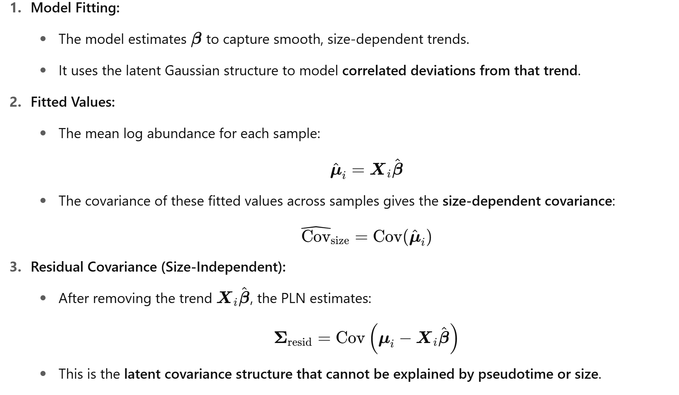
PLN Models for studying cell type covariance
35

Slide 38
Why Investigate Size-Independent Covariance?
In complex biological systems—such as during regeneration or development in planaria—cell type abundances are driven by a combination of intrinsic biological programs and extrinsic covariates (e.g., size, pseudotime). These dynamics manifest in cell count matrices with overdispersion, nonlinearity, and correlated fluctuations across cell types. To capture this structure, the Poisson Log-Normal (PLN) model introduces a latent Gaussian layer that encodes the unobserved multivariate structure governing cell fate dynamics.
What can this do?
Identify Lineage Coupling or Fate Constraints: Some cell types may be developmentally linked (e.g., progenitor and early progeny). Their abundances fluctuate together across samples, regardless of size. This could signal branching fate restrictions, co-differentiation, or progenitor-progeny coupling.
Detect Functional Modules or Niche Effects: Groups of cell types with shared functional roles or tissue organization may exhibit correlated behavior.
Reveal Hidden Heterogeneity: If size-dependent trends explain most of the variation, residual structure may still reflect technical artifacts, hidden covariates, or biological substructure. Understanding this residual structure improves normalization and interpretability of abundance shifts.
36
Notes:
Why use a latent Gaussian?
Real biological count data (like cell type abundances) are overdispersed (variance > mean) and correlated.
A Poisson model alone cannot capture this.
Introducing a latent Gaussian structure in the log space adds flexibility to model:
Overdispersion
Correlations between cell types
Covariate effects (like size, pseudotime)

Slide 39
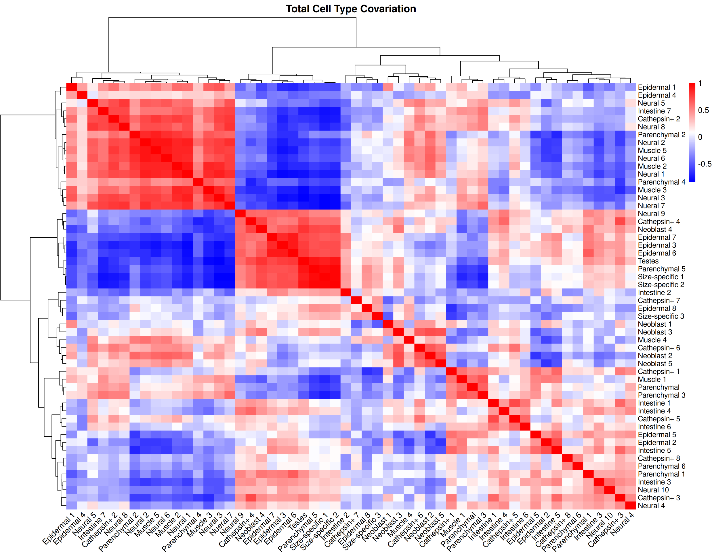
37

Slide 40
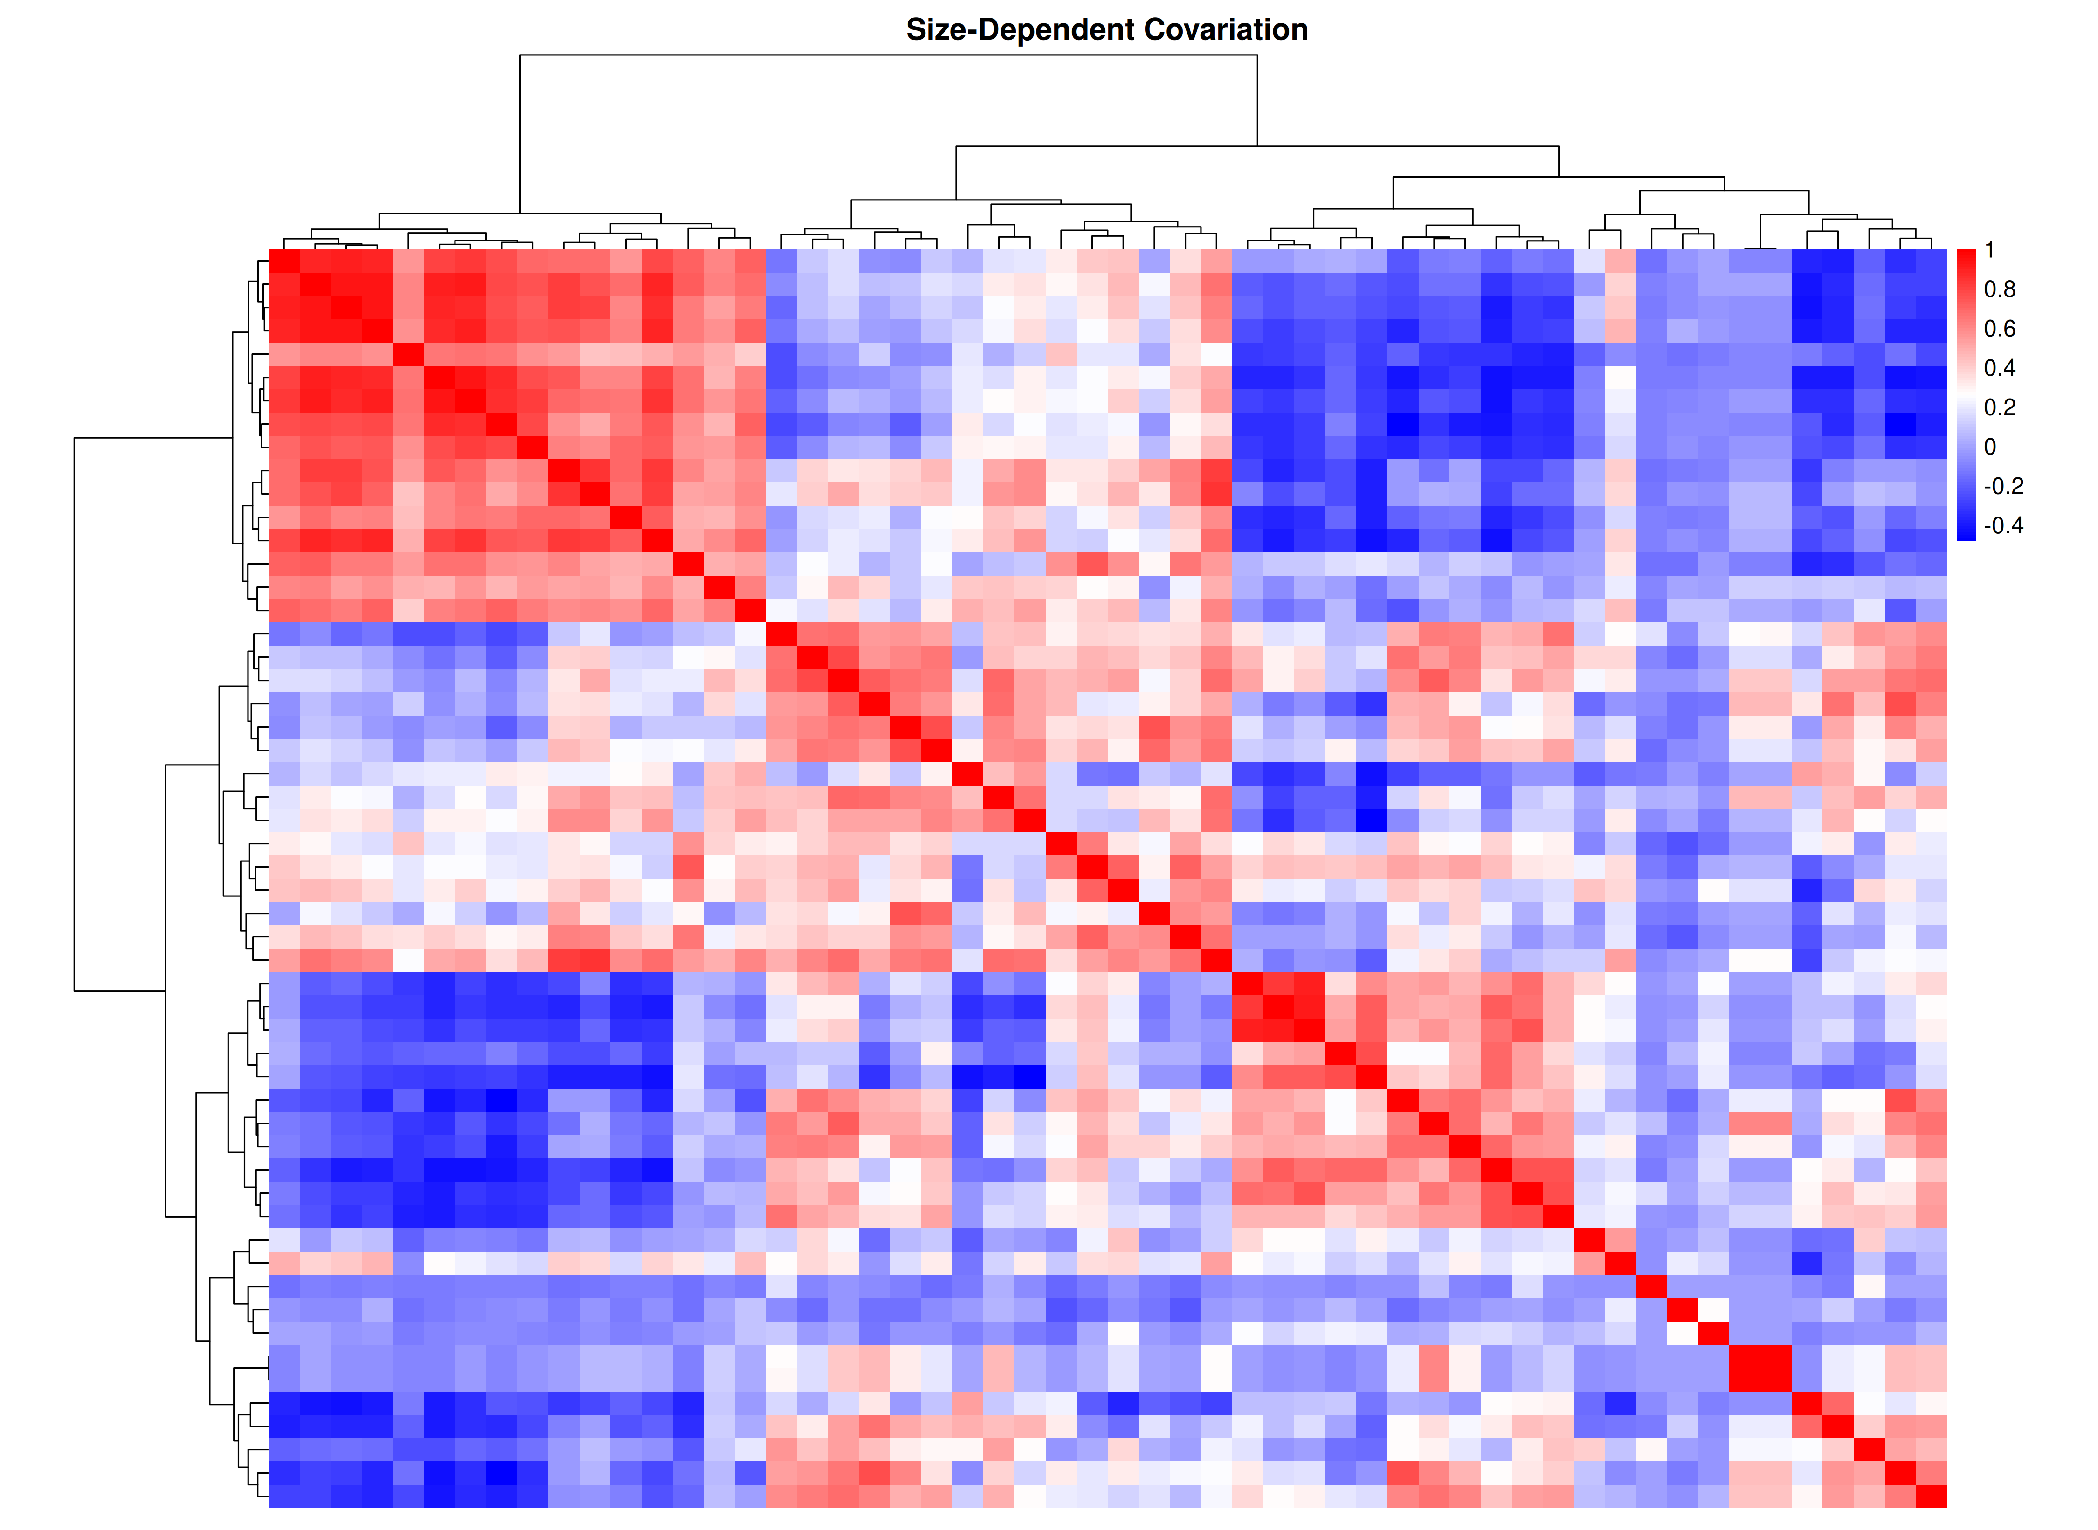
38

Slide 41
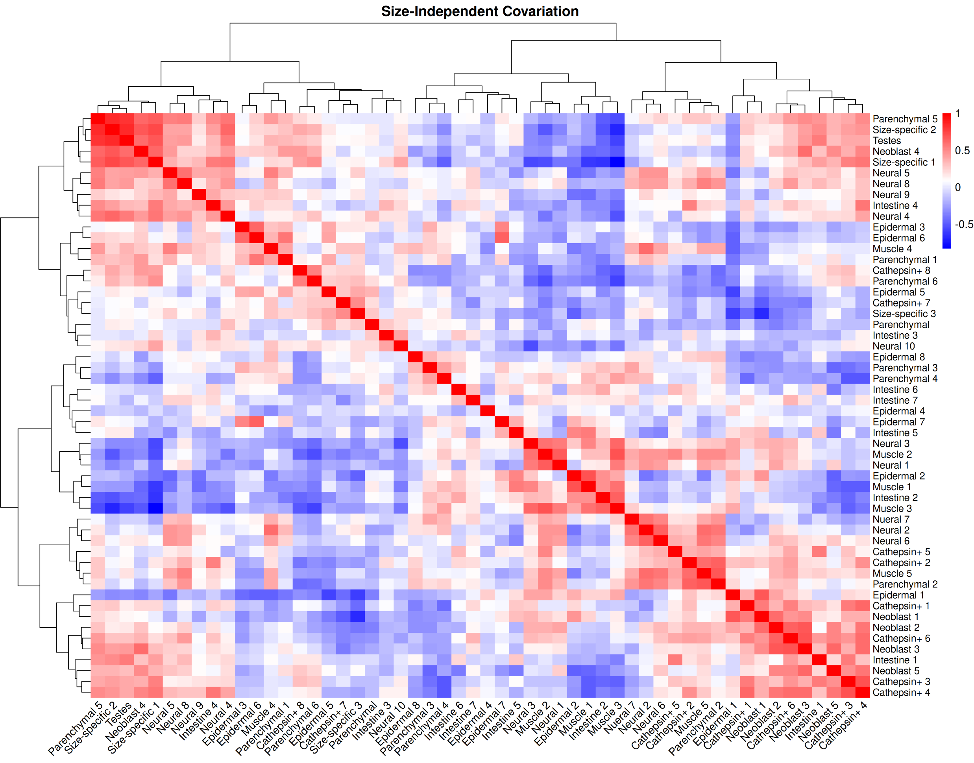
39

Slide 42
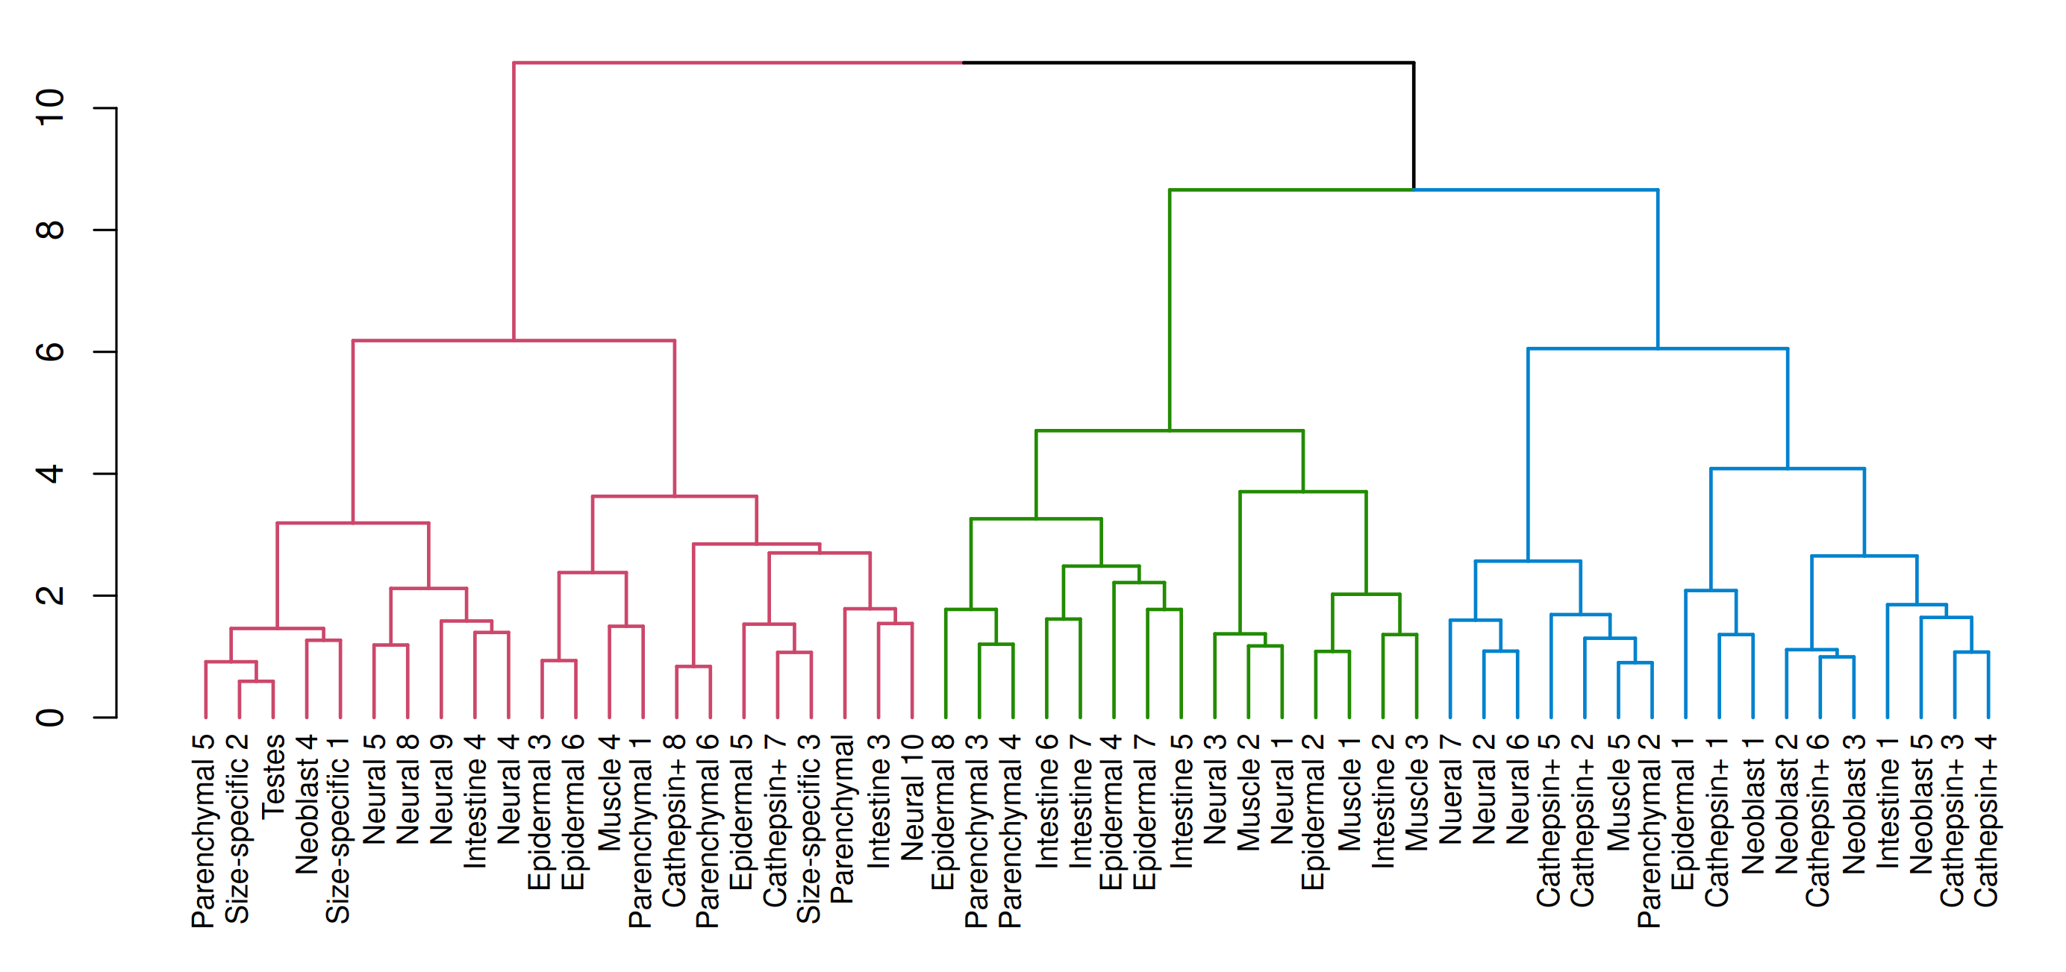
Size-Independent Covariance
40

Slide 43
Limitations of the Study
The present study is centered on establishing a computational and mathematical framework. Consequently, inherent limitations constrain the immediate biological interpretability of the results.
A few of the cell type annotations remain provisional, requiring further experimental validation to ensure accurate biological interpretation.
Pseudotime, while correlated with worm size and developmental progression, does not fully capture the complete biological heterogeneity or lineage-specific complexity inherent to the system.
Data sparsity and limited sample sizes, particularly for rare or transient populations, may reduce sensitivity to subtle but biologically relevant signals.
Modeling assumptions—including spline degrees of freedom, distributional choices, and window parameters—impact the robustness and sensitivity of findings and warrant further tuning and validation.
41

Slide 44
Next Steps
Extend trajectory-specific modeling by systematically applying negative binomial and beta binomial regression to all cell types across each pseudotemporal trajectory, enabling a comprehensive view of abundance dynamics and dispersion patterns.
Analyze spatial autocorrelation of cell type distributions along pseudotime trajectories using metrics such as Moran’s I to uncover localized structure, developmental niches, or coordinated patterning across cell states.
Develop an in silico perturbation framework by sampling synthetic worms from the size-independent covariance matrix of cell type abundances, enabling computational testing of how targeted compositional shifts affect pseudotemporal trajectories and reproductive fate bifurcations.
And on a lighter note… Hope that this framework brings some meaningful impact in Gaurav’s future experiments! :)
42

Slide 45


A special mention to Mike, Hanh, Gaurav and all the members of the Dorrity Group…

